Slide 1
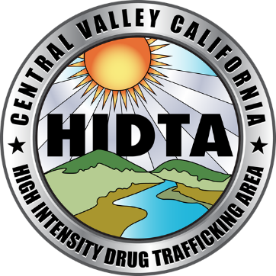
Central Valley California HIDTA
Ashlee Zarou
Drug Intelligence Officer

Slide 2
2021 Prices & Seizures
○ In October 2021, 5 pounds of methamphetamine sold in the Sacramento area for $7,600 (about $1,520 per pound)
○ SAINT seized the following amount of methamphetamine:
1st quarter of the year: 90 pounds
2nd quarter of the year: 134 pounds
3rd quarter of the year: 81 pounds
4th quarter of the year: 144 pounds
Total: 449 pounds of meth seized in 2021 just from Sacramento County

Slide 3
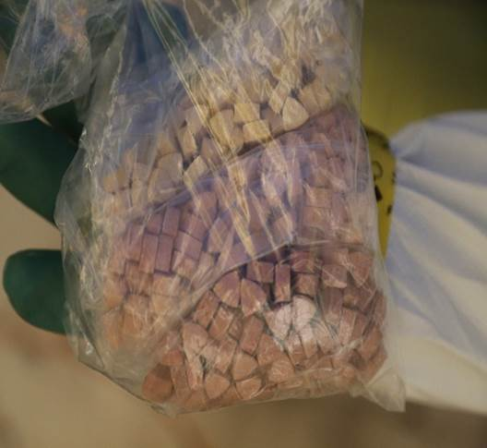
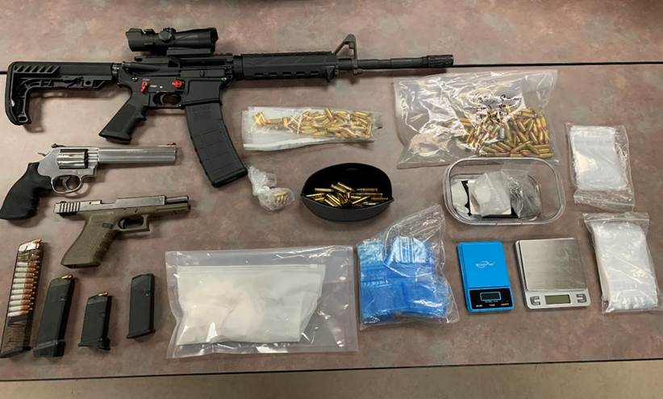
Bust from Sacramento County. Bottom bag is fentanyl and blue bag is methamphetamine from a street dealer.
Ecstasy pills
(Photos courtesy of SAINT)

Slide 4
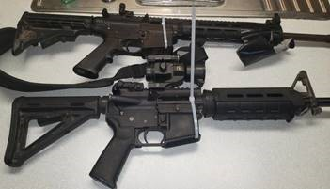
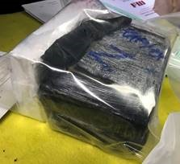
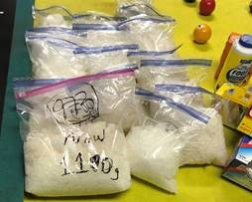
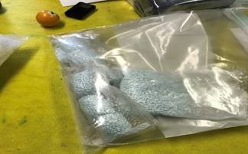
○ Seizure from Sacramento area drug trafficking organization. Agencies involved in the investigation included: HIDTA, FBI, DEA, ATF & Cal-MMET.
○ Several federal and state search warrants were executed that resulted in 11 arrests and the seizure of 45.7 pounds of methamphetamine, 10.8 pounds of cocaine, 4.14 pounds of heroin, 65 pounds marijuana, 16 firearms and $303,095 US currency.
(Photos courtesy of SAINT)

Slide 5
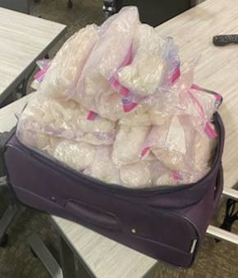
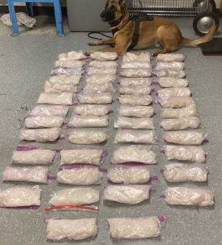
○ DHE Detectives were working Highway interdiction on Highway 99 within Sacramento County when they observed a pick-up with violations of the California Vehicle Code. Detectives initiated a traffic enforcement stop for the violations. Detectives obtained consent to search the vehicle after obtaining a canine alert to the exterior of the vehicle. A suitcase was located which contained approximately 50 pounds of methamphetamine. The registered owner took ownership of the methamphetamine. The registered owner was arrested and booked into the Sacramento County Main Jail.
(Photos courtesy of SAINT)

Slide 6
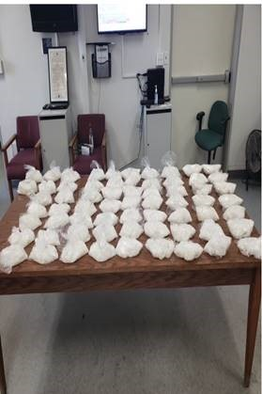
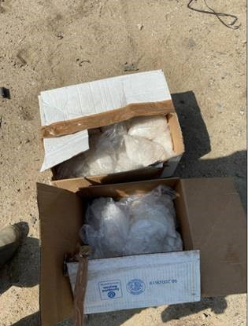
○ HIDTA and CAL-MMET Detectives identified a vehicle that was possibly transporting narcotics. Detectives conducted surveillance on the vehicle. Once in the area of HWY-99 in the city of Tipton, Detectives requested a wall stop. Tulare County Sheriff’s Patrol K9 Unit conducted a wall stop on the suspected vehicle on HWY-99 in Tulare County. During the traffic stop, CHP located approx. 66 pounds of methamphetamine and the suspect was arrested.
(Photos courtesy of Tulare County)

Slide 7
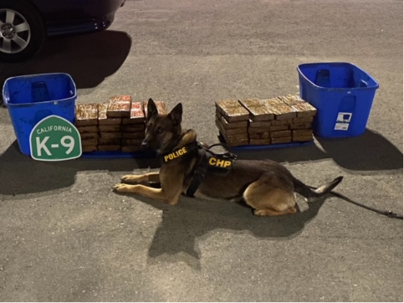
○ HIDTA and CAL-MMET Detectives identified a vehicle that was possibly transporting narcotics. Detectives conducted surveillance on the vehicle. Once in the area of HWY-99 in the city of Selma, Detectives requested a wall stop. Fresno CHP K9 Unit conducted a wall stop on the suspected vehicle on HWY-99 and E Mountain View Ave in Fresno County. During the traffic stop, CHP K9 alerted and located approximately 129 pounds of methamphetamine in the trunk of the vehicle. The suspect was placed under arrest and booked into Fresno County Main Jail.
(Photos courtesy of FAST)

Slide 8
Contact Information
Ashlee Zarou
Drug Intelligence Officer
azarou@sacsheriff.com
(916)282-8349
Cvchidta.org

