Slide 1
POP TEAM
Deputy Josh Wanner & Deputy Spencer Wright

Slide 2
Roles and Responsibilities
Identify and reduce long term crime problems with in the community
Gather and analyze crime statistics
Investigate anonymous tips
Attend community meetings to be a conduit from the public to Law Enforcement.
Collaborate with Intelligence analyst to produce and Intelligence Led Policing Model for Patrol Shifts
* Recently the North POP team’s primary focus has been to investigate and reduce street level narcotic sales.

Slide 3
Emerging Trends in Methamphetamine/ Fentanyl
Found to be more readily available on the street.
- The POP Team has been contacting more people with a useable amount of methamphetamine.
Reduced Price for Methamphetamine.
- Meth prices are at an all time low. According to the Los Angeles HIDTA Drug Sheet April-June 2021, 1 Gram of meth is sold only $20-$30 dollars.
Increase in Fentanyl on the street.
- The POP Team has seen a large increase in the number of people possessing Fentanyl. The Fentanyl has been dyed several different colors such as pink and blue. According to an arrestee, dealers are dying the drugs as a marketing gimmick.

Slide 4
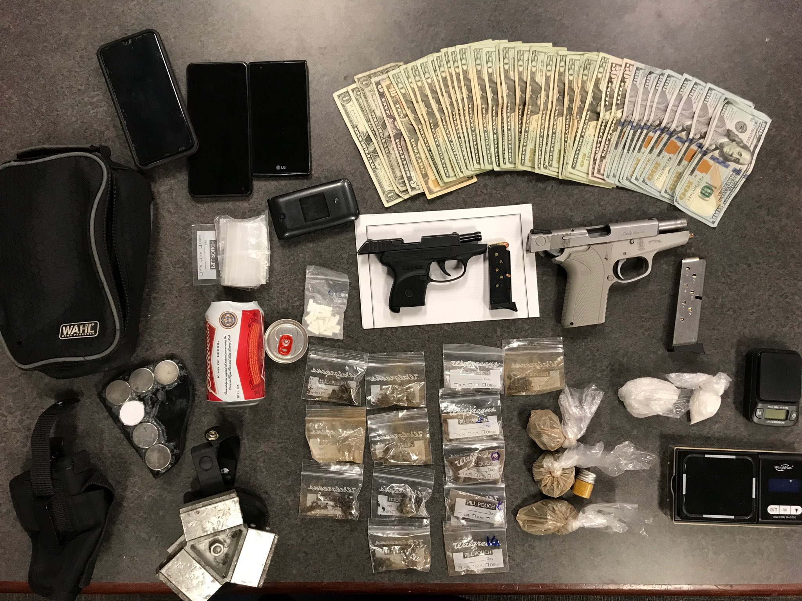

Slide 5
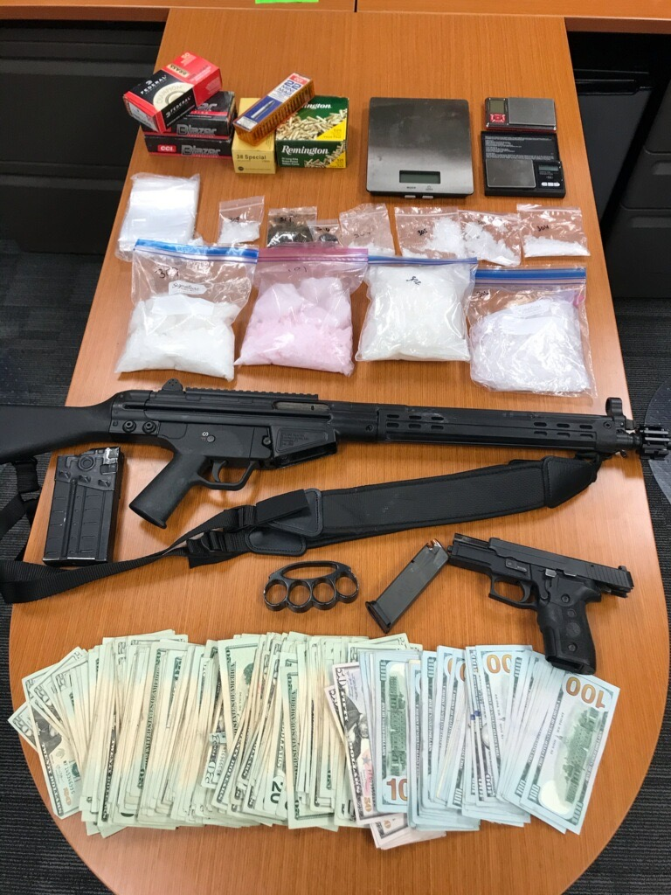

Slide 6
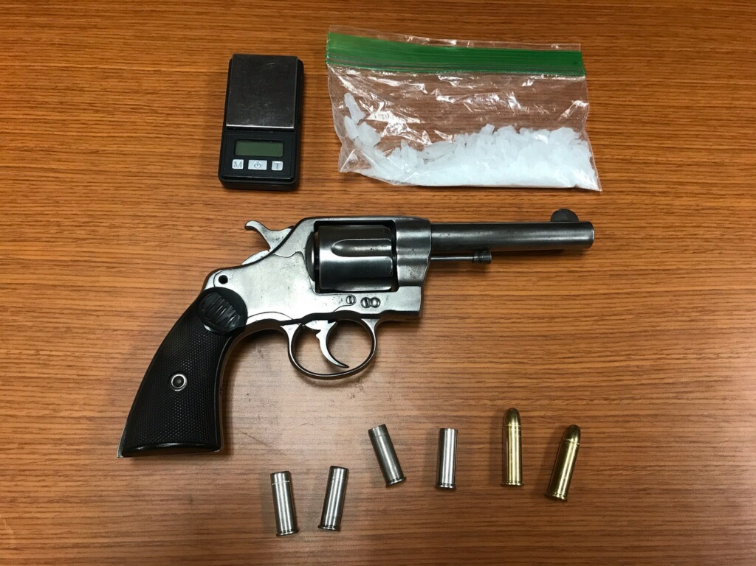
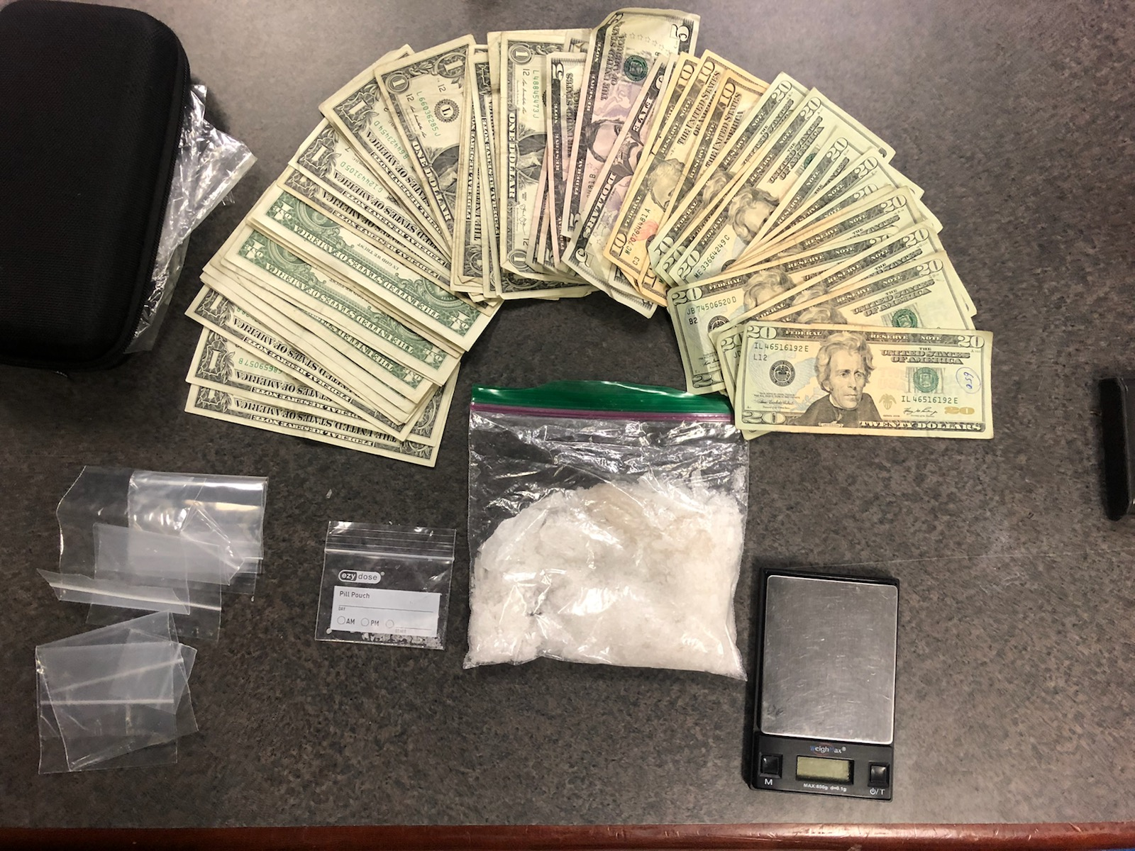

Slide 7
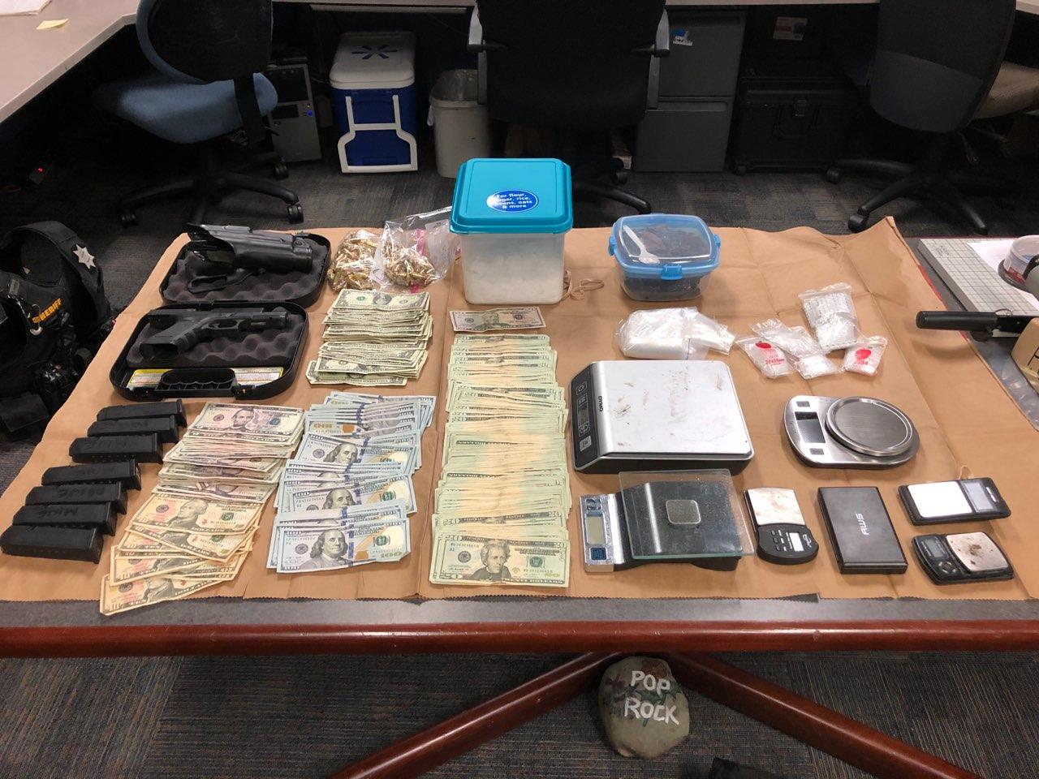

Slide 8
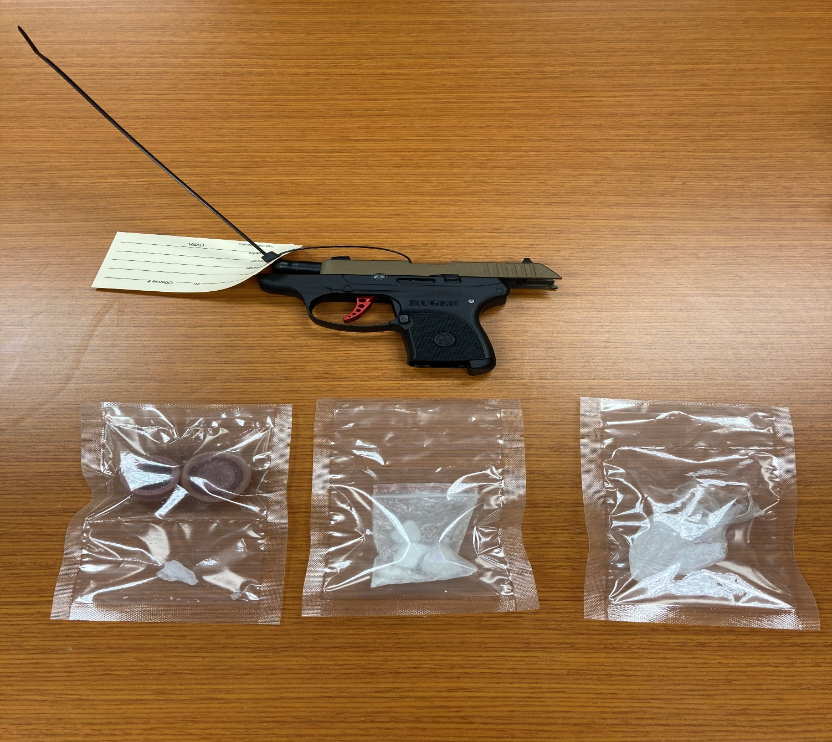
FENTANYL

Slide 9
Contact Information
Sacramento County Sheriff
916-874-5115 (NON-Emergency)
916-874-5111 (Emergency)
North POP TEAM
Northpop@saccheriff.com
916-876-5729

