Slide 1
Presentation to Sacramento County Methamphetamine Coalition May 12, 2022

Slide 2
03 Background 08 Landscape Analysis
14 Messaging: Black Women and Their Support Systems
21 Messaging: Providers and Policymakers
28 Results To-Date
34 Looking Ahead
Table of Contents

Slide 3
Background

Slide 4
See Her Bloom https://www.seeherbloom.org
The See Her Bloom social media campaign seeks to eliminate the stigma often faced by Black women who experience substance use disorders as they search for treatment and recovery resources. The campaign creates a unique and trauma-informed platform for Black women to give voice to their own experience with substance use and misuse and to take ownership over their own healing. See Her Bloom is the creation of the Center for Collaborative Planning, Public Health Institute and funded by The Center at Sierra Health Foundation. The campaign was launched in 2020 with focus on opioid use disorders and has now expanded to include a focus on stimulant use.

Slide 5
Project Outcomes
Gender informed and culturally responsive messaging to reduce/prevent stigma for Black women at risk for stimulant use disorders.
Social media campaign to educate Black women and providers about influence of stimulants. Platforms include Facebook, Instagram, and See Her Bloom website, including resource page on stimulant use prevention and treatment.
Curated stories from Black women at risk for and/or with lived experience of stimulant use disorder.
Gender informed, culturally responsive resources to address stimulant use disorder among Black women across California.

Slide 6
Timeline and Milestones September 2021 – August 2022
Q4: 2021
Advisor Kick-off
Landscape Research
Message Development
Advisors Meeting on Messaging
(December 2021)
Q1: 2022
Website Updates
Social Media Toolkit
Social Media Training
Campaign Launch
Advisors Meeting #2
(March 2022)
Q2-Q3: 2022
Influencer Engagement
Growing Reach
Growing Resources
Curating Prevention and Treatment Resources
Data and Performance
Advisors Meeting #3
(July 2022)

Slide 7
See Her Bloom Advisors
Tanesha Atwell, Reach Out, San Bernardino County
Ranita Harris, African American Healing Network, Sacramento County
Karen Hill, Health Management Associates, Alameda County
Theresa Hunter, Community Representative, Sacramento County
Sydney McKinney, National Black Women’s Justice Institute, New York

Slide 8
Stimulant Use
Landscape Analysis

Slide 9
Overview of Activities
Three focus groups:
Prevention and treatment providers
Black women with lived experience with stimulant use
Staff of community-based organizations providing community services
Literature review:
Researching articles and studies on perceptions of and by Black women and stimulant use – related to treatment and recovery
Understanding use and treatment statistics in California

Slide 10
Substance Use Data
There is a general lack of data relative to Black women
Current data collection focuses heavily on opioid use
People who use stimulants are 10x more likely to misuse opioids
In CA, methamphetamine is the most prevalent drug reported (33%) at treatment admission (general population)
In CA, black populations have higher death rates from amphetamine-related overdose deaths at 7.9 per 100,000 compared to the state rate of 4.6 per 100,000.

Slide 11
Barriers to Treatment and Recovery
Lack of trust in the medical profession by the individual, family and community
History of bias, stigma, racism, experimentation
Lack of Black providers
Providers are unwilling to discuss racism and racial trauma
Medical profession not treating people like whole persons
Stigma related to substance use disorder and mental health issues
Self-stigma, stigma from family and community
Getting treatment may mean loss of employment, loss of parental status
Criminalization of drug use
“White people go to rehab, Black people go to jail.”

Slide 12
Barriers to Treatment and Recovery
Lack of affordable inpatient facilities
Affordable recovery centers are often not well-funded, not well kept up - demeaning
Lack of good information about treatment options
Requirement for abstinence before receiving treatment
Need to change entire lifestyles, communities, partners
Fear of what treatment means – the changes required, what will happen

Slide 13
What Works
Having support – someone to talk to, someone who can connect you with resources – a sponsor, trusted connection, a good counselor who builds trust
Having pride in recovery, in progress. Sharing that pride because it is more important than the stigma.
Having women with lived experience share their stories as trusted communicators
Providers understanding the barriers to treatment – understanding trauma, including racial trauma
Trusted community-based organizations connected with trusted culturally appropriate treatment providers
Full, wrap-around services: housing, employment, addressing trauma
Motivational interviewing, harm reduction, strong peer to peer networks

Slide 14
Messaging Black Women and Their Support Systems

Slide 15
Topline Message:
Information is not enough. Black women deserve holistic treatment that includes mental and community care.
Message 1 (The Problem):
Black women experience disproportionate risks from substance use disorders, and not enough is being done to address it.
Message 2 (The Solution):
Don’t judge Black women for substance use — instead treat us as human beings worthy of living healthy and thriving lives.
Message 3 (Our Needs):
Black women deserve holistic care that meets their physical, mental, spiritual, and social needs.

Slide 16
Message 1: The Problem
Black women experience disproportionate risks from substance use
disorders, and not enough is being done to address it.
Substance-related overdose deaths in the Black community increased by 40% from 2015 to 2016, compared to only a 21% increase across the overall population.
From 2004 to 2019 the death rates of cocaine overdoses –– a commonly used stimulant –– were higher among the Black community compared to other racial and ethnic groups.
Black women are disproportionately impacted by stimulant use disorders.
Black women with addiction are seen as failures instead of being seen as having a health issue that needs treatment;
When Black women come forward and speak about their substance use they are at risk of having their children taken away;
Black women are more likely to be incarcerated and aren’t referred to
treatment or rehab centers.

Slide 17
Message 2: The Solution
Don’t judge Black women for our substance use — instead treat us as human beings worthy of living healthy and thriving lives.
Every Black woman struggling with substance use has a story –– we are more than our dependency, we are worthy of support and healing and we deserve to be heard.
It’s time to break down the misconceptions, stigma, shame, and guilt faced by Black women who use substances.
Black women with substance use disorder are not bad mothers, welfare queens, and crackheads –– we need support and care, not punishment.
It’s time to start examining why addiction impacts our community instead of finding fault with people who have substance use disorders..
14

Slide 18
Message 3: Black Women’s Needs
Black women deserve holistic care that meets their physical,
mental, spiritual, and social needs.
We need our loved ones to understand us, lift us up, and stand by us during our time of need.
Support looks different depending on the circumstance. No gesture is too small. Offering rides to treatment, babysitting or advocating for us in the doctor's office all make the difference when Black women are in need of care.
Spirituality can be a key source of strength during treatment for Black women and their loved ones –– Black women want to be well spiritually, physically, and emotionally.
14

Slide 19
Message 3: Black Women’s Needs (Cont’d)
Black women deserve holistic care that meets their physical,
mental, spiritual, and social needs.
Recovery looks different for everyone and when treating addiction among Black women it’s important to understand how trauma, racial inequity, income, and transportation can be contributing factors and/or barriers to treatment.
Effective treatment needs to be accessible and accommodating to Black women’s economic background, role as a family caretaker, and time restrictions.
With the support, resources, and culturally competent care –– acknowledging where the patient is coming from both personally and in the context of broader societal inequities –– Black women can have the best chances at recovery.
14

Slide 20
Messaging Providers and Policymakers

Slide 21
The Messages
Topline Message:
Black women need to be treated with care and empathy, not prison and punishment.
Message 1 (The Past):
It’s time to talk about the impact of the war on drugs on Black women.
Message 2 (The Present):
Black women battling substance use disorder is a health issue, not a criminal one.
Message 3 (The Future):
We envision a future where zip code, income, and race do not dictate the care Black women receive.
21

Slide 22
Message 1: The Past
Topline Message:
It’s time to talk about the impact of the war on drugs on Black women.
The War on Drugs, a political effort to criminalize drug use, disproportionately
impacted Black and Brown people in a way that still impacts communities decades
later.
The impact of treating drug use as a criminal issue results in mothers being
taken away from their children, men being taken away from their families, and
oftentimes women having to be the sole provider in their household.
70% of women charged with fetal abuse are women of color.
Jail and prison do not provide adequate treatment. Addressing substance use
among women should focus on the ways poverty impacts the health and life
outcomes of Black women.
Without acknowledging the impact of poverty, structural inequality, abuse, and
trauma that Black women experience, Black women will continue to be
criminalized.
The healthcare system has an opportunity to play a role in decriminalizing drug
use by treating it as a health issue and not a criminal one.
21

Slide 23
Message 2: The Present
Topline Message:
Black women battling substance use disorders is a health issue, not a criminal one.
Multiple national population surveys have found that about half of those who
experience a mental illness during their lives will also experience a substance use
disorder and vice versa
Mental health is just as important as physical health in the healing journey
for Black women impacted by substance use disorder.
Treatment needs to not only address substance use, it also needs to address
the mental health stressors that lead to substance use.
The reasons for using substances are complex and are often linked with
generational and historical trauma, poverty, abuse, and sexual violence.
When you have to worry about being arrested, having children taken away, and
disrespect, we aren’t willingly seeking out help.
In the media and by political leaders, Black women with substance use
disorder are labeled as welfare queens and crack babies/heads.
21

Slide 24
Message 3: The Future
Topline Message:
We envision a future where zip code, race, income do not dictate the care that Black women receive.
Effective treatment needs to be accessible and accommodating to Black women’s
economic background, transportation access, role as a family caretaker, and time
restrictions, especially when oftentimes, the circumstances overlap
Talking to Black women about treatment options that work for them and
advocating for low-barrier substance use treatment options can ensure that they
have the information they need to make the best choice for themselves.
In addition to more transparency providing honest, science-based
information and promoting safety through personal responsibility and
knowledge in a way that’s relatable can help Black women feel supported
and encouraged to seek support.
Connections to public health and social services resources during treatment
discussions can create low barriers for Black women who lack access to
treatment centers or resources.
21

Slide 25
Message 3: The Future (Cont’d)
Topline Message:
We envision a future where zip code, race, income do not dictate the care that Black women receive.
We can’t stop there. We must actively work to challenge stereotypes and
assumptions in the health and behavioral health field.
We must ensure that the diversity of providers reflects that of our
patients and create opportunities for service providers to participate in trainings that inform them of the cultural context and needs of Black women.
There’s an opportunity to capture more diverse data that centers Black
women and the specific impact substance use disorder has on the Black
community.
With the proper support, resources, and culturally competent care, every Black
woman experiencing substance use can find the best path to recovery and
personal fulfillment to thrive, not just survive.
21

Slide 26
Results To-Date

Slide 27
Social Media Metrics
See Her Bloom has reached over 828K people over its lifetime.
800 new users of the website since re-launch in March 2022.
Average time spent on site is 1:23.
44 posts on Facebook, Instagram & Twitter March-April.
Top performing page is consistently Resources for Black Women.
Facebook generated most engagements compared to other platforms.

Slide 28
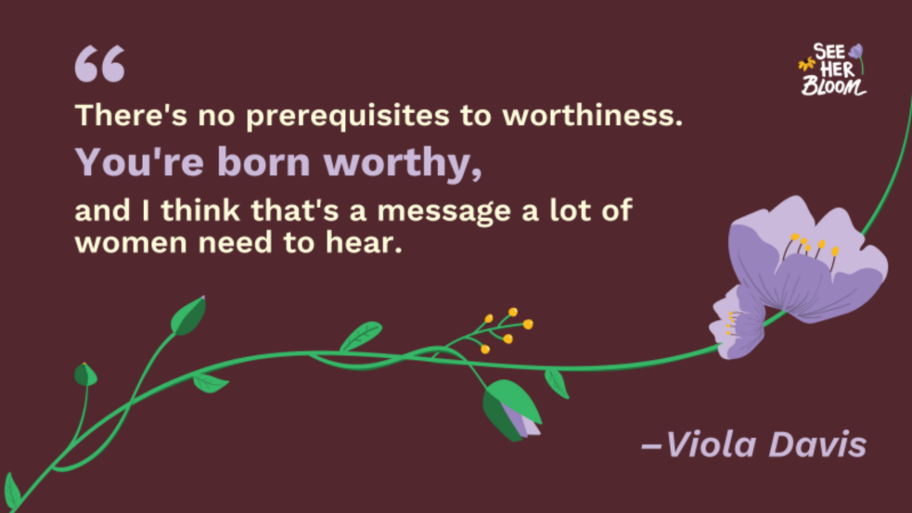
Content Categories and Examples
Fighting Stigma

Slide 29
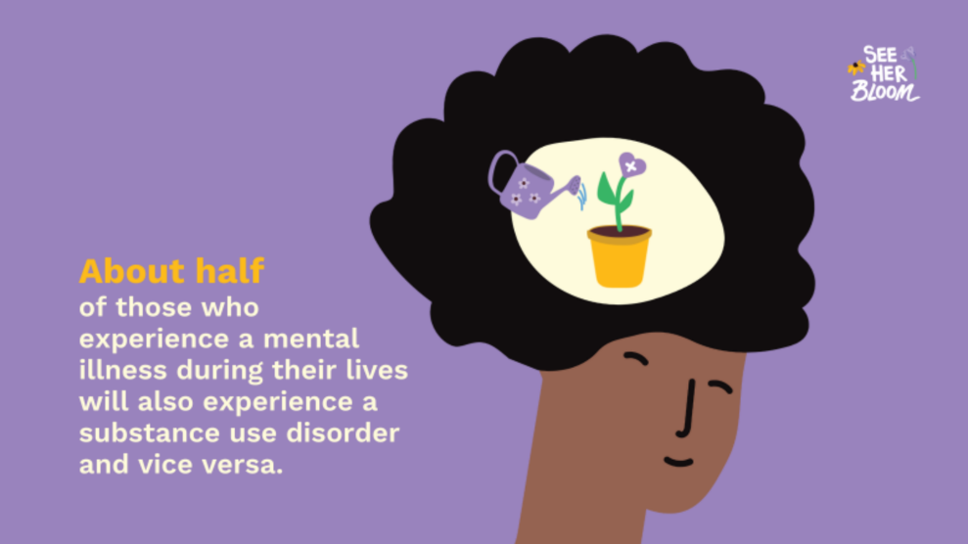
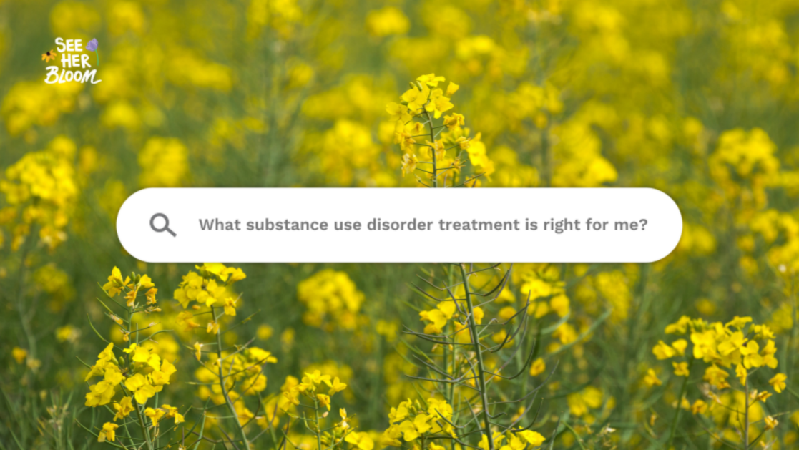
Content Categories and Examples
Awareness/Education
Share and Submit Stories
Family and Loved Ones Resources
Impacted Women Resources
Criminalization of Drugs
Mental Health

Slide 30
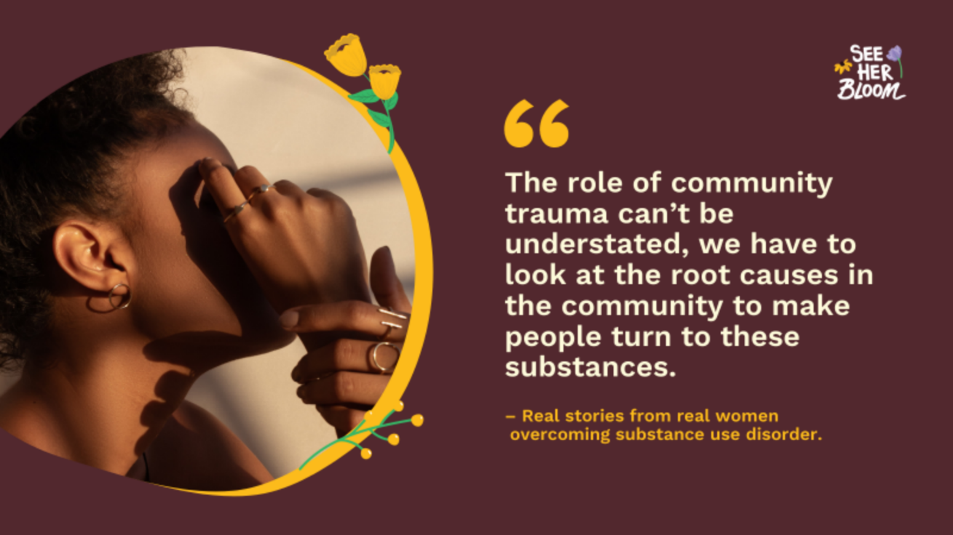
Content Categories and Examples
Testimonial
Share and Submit Stories
Provider Resources
Potential reasons for stimulant use: 👵🏾Generational and historical trauma ❤️‍🩹Abuse 💜Sexual Violence 🧠Mental Health disorder Black women need to be met with treatment, not jail. See how providers can improve the lives of Black women: https://seeherbloom.org/providers-resources-stimulants/

Slide 31
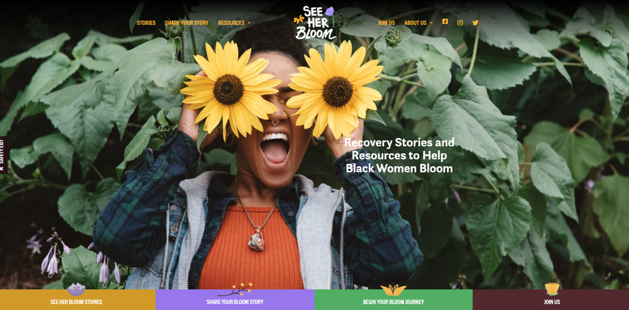
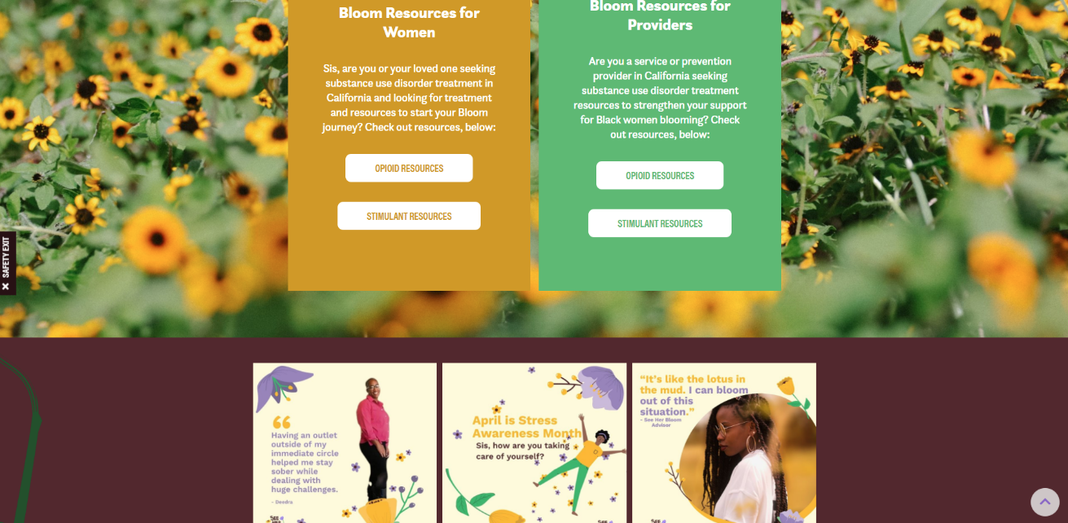
W e b s ii t e
We needed a home for our public engagement campaign focused on empowering impacted Black women in California to seek access to treatment options. We set out to create a website, SeeHerBloom.org, that serves as the online hub for the campaign with stories as well as resources.
We envisioned:
+ A safe space for Black women to share their experiences and feel comfortable seeking out services and treatment
+ A learning center for service providers to get educated about how trauma, racial inequity, and income play a part in the care Black women receive
+ A platform that promotes dialogue on the impact of the opioid epidemic on Black women

Slide 32
Looking Ahead

Slide 33
Looking Ahead
+ Follow and share our content on social media
+ Help us to reach out and engage impacted women to share their story on the See Her Bloom website
+ Connect us with community leaders from other impacted groups of women
+ Talk early, often, and out loud about the disparate impact of stimulant use and misuse for Black women
+ Connect See Her Bloom to potential supporters, donors, and advocates
+ Consider: How might See Her Bloom be useful to your work?
The See Her Bloom campaign is effectively changing the narrative around stimulant use and misuse and creating a platform of empowerment for impacted Black women. To the right are ways you can help.

Slide 34
References
A Qualitative Study of Black Women’s Experiences in Drug Abuse and Mental Health Services, 2015
https://journals.sagepub.com/doi/10.1177/0886109914531957
White People Go to Rehab, Black People Go to Jail, 2020
https://www.workithealth.com/blog/white-people-go-to-rehab-black-people-go-to-jail/?fbclid=IwAR3_q4R6QVyqJxXdNFSzFXinsHWCwE4OGfE2bg4NrNWxzRa7oz6zxab6-PE
Williams, R. (2008). Cultural Considerations in AOD Treatment for African Americans. 2008
https://oklahoma.gov/content/dam/ok/en/odmhsas/documents/a0003/cultural-consid.pdf
Mental Health of Black Girls: The Case for Gender-Specific and Culturally Affirming Services. National Black Women’s Justice Institute, October 2021
https://950b1543-bc84-4d80-ae48-656238060c23.filesusr.com/ugd/0c71ee_4d42be28ce5b4d3d913115fa165be6e3.pdf
Brome, D.R., Owens, M.D., Allen, K., and Vevaina, T. (2000). An Examination of Spirituality among African American Women in Recovery from Substance Abuse. Journal of Black Psychology, 26(4), 471-486. (2000)
https://journals.sagepub.com/doi/abs/10.1177/0095798400026004008?journalCode=jbpa
Attitudes & Stigma Around Addiction, Addiction Technology Transfer Center Network Webinar. October 27, 2021.
https://adai.uw.edu/nwattc/pdfs/webinar-202110.pdf
What is Racial Trauma? Understanding Race-Based Traumatic Stress, 2021
https://www.relias.com/wp-content/uploads/2021/03/21-HHS-BH-2881-Whitepaper-WhatIsRacialTrauma-2-1.pdfto
The rise of illicit fentanyls, stimulants and the fourth wave of the opioid overdose crisis, 2021
https://journals.lww.com/co-psychiatry/fulltext/2021/07000/the_rise_of_illicit_fentanyls,_stimulants_and_the.4.aspx
How to Make Antiracist Work a Part of Your Recovery Program, 2020
https://www.thetemper.com/antiracism-work-in-recovery-spaces/

Slide 35
Thank You! Connie Chan Robison, Executive Director Center for Collaborative Planning Connie@connectccp.org www.connectccp.org #SeeHerBloom

