Slide 2
Methamphetamine Use Among Asian/Native Hawaiians and Other Pacific Islanders (NHOPI)
SAMHSA Document, July 2022

Slide 3
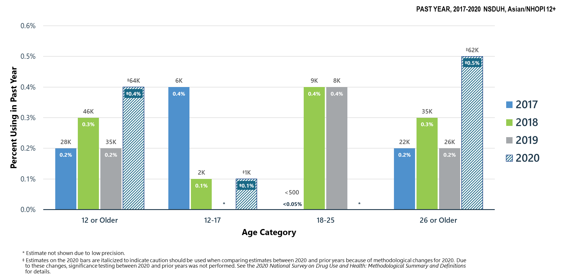
Methamphetamine Use in Past Year: Among Asian/NHOPI People Aged 12+
Notes:
The estimates in these slides have been rounded for the purposes of presentation. Any appearance of estimates not summing exactly to a known total are due to this rounding.
Some slides present the same analysis across multiple years. The underlying populations from which these estimates are derived change across years since the number of people in the United States changes across years. Thus, a change in proportions does not equal a constant change in the weighted count.
Talking Points:
Although methamphetamine is legally available by prescription (Desoxyn®), most methamphetamine used in the United States is produced and distributed illicitly rather than through the pharmaceutical industry. The misuse of prescription stimulants is covered on the next slide.
Estimates for Asian/NHOPI young adults aged 18 to 25 could not be calculated with sufficient precision.

Slide 4
Other Substance Use in 2020
Among Asian/NHOPIs aged 12 to 17 in 2020:
0.1 percent (or 1,000 people) used methamphetamine in the past year
0.1 percent (or 3,000 people) misused prescription stimulants in the past year
Among Asian/NHOPIs aged 18 to 25 in 2020:
2.2 percent (or 45,000 people) misused prescription stimulants in the past year
1.1 percent (or 23,000 people) used LSD in the past year
Among Asian/NHOPIs aged 26 or older in 2020:
0.8 percent (or 101,000 people) used cocaine in the past year
0.5 percent (or 62,000 people) used methamphetamine in the past year
0.7 percent (or 97,000 people) misused prescription stimulants in the past year
0.6 percent (or 84,000 people) used LSD in the past year

Slide 5
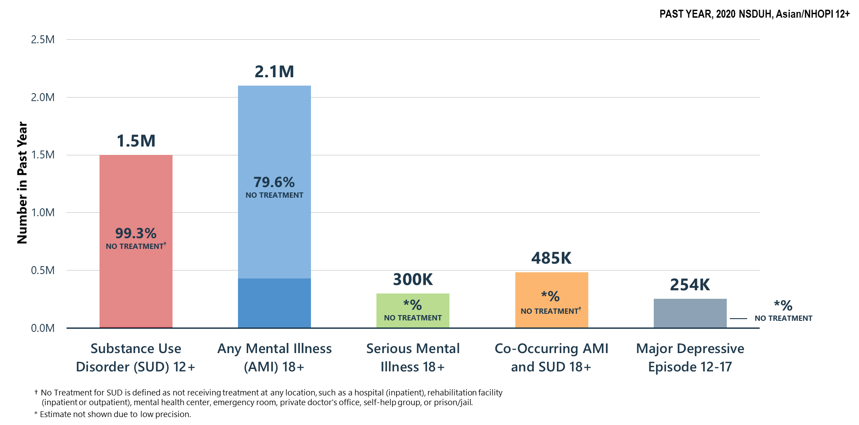
Did Not Receive Substance Use Treatment or Mental Health Services in Past Year: Among Asian/NHOPI People Aged 12+
Notes:
The estimates in these slides have been rounded for the purposes of presentation. Any appearance of estimates not summing exactly to a known total are due to this rounding.
Some slides present the same analysis across multiple years. The underlying populations from which these estimates are derived change across years since the number of people in the United States changes across years. Thus, a change in proportions does not equal a constant change in the weighted count.
TALKING POINTS:
Understanding barriers to and increasing access to SUD and mental health treatment remains a focus for providers and policymakers.
Well-established barriers to care include lack of insurance/cost, stigmatization of substance use and mental illness, and multicultural factors.
Over three quarters of Asian/NHOPI adults aged 18 or older with AMI did not receive treatment within the past year.
Far fewer Asian/NHOPI adults sought help for SUD. More than 90 percent do not receive treatment—highlighting barriers to care including stigmatization of SUD.

Slide 6
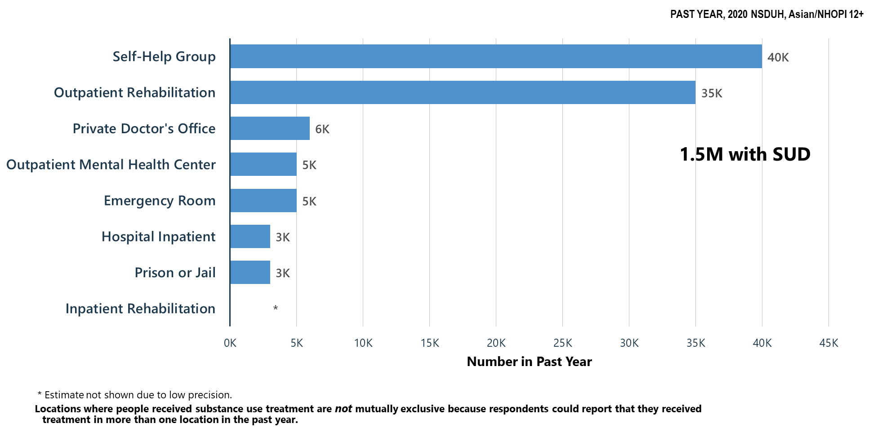
Locations Where Substance Use Treatment was Received in Past Year: Among Asian/NHOPI People Aged 12+
Notes:
The estimates in these slides have been rounded for the purposes of presentation. Any appearance of estimates not summing exactly to a known total are due to this rounding.
Some slides present the same analysis across multiple years. The underlying populations from which these estimates are derived change across years since the number of people in the United States changes across years. Thus, a change in proportions does not equal a constant change in the weighted count.
TALKING POINTS:
The popularity of self-help groups (e.g., Alcoholics Anonymous) is in part due to reduced fears of stigmatization (or being misunderstood) because group leaders have shared lived experiences (Moos, 2008). In addition, self-help groups are typically free.
Moos, R. H. (2008). Active ingredients of substance use‐focused self‐help groups. Addiction, 103(3), 387-396.

Slide 7
Barriers to Treatment
Health Insurance didn’t cover
Didn’t think anyone could help
Didn’t know of any place to go for help
Couldn’t afford the bill
No transportation
Thought the problem would get better by itself
Too embarrassed to discuss it with anyone
Afraid of what others may think
Hated answering personal questions
Journal of Substance Abuse Treatment, December 2021, vol. 131

Slide 8
Asia’s Methamphetamine Cartels

Slide 9
According to CNN Correspondent, Heather Chen
More than one billion methamphetamine pills were seized in East and Southeast Asia last year, a record figure that the United Nations says highlights a “staggering” increase in the regional synthetic drug trade
Organized crime groups have taken advantage of recent political instability that has left some borders largely lawless and easy to export
There has been a continued drop in prices of crystal methamphetamine in Southeast Asia, (Malaysia and Thailand), while the purity of the drug remains high, which means greater affordability and accessibility of high-purity drugs
In Southeast Asia, a region with a population of more than 680 million people across 11 countries, methamphetamine is a booming multibillion-dollar trade that has supplanted opium and its derivative heroin to become the dominant illegal drug for both use and export
Published, May 31, 2022

Slide 10
Thank you,
Kimberly Grimes, SUPT BHREC Liaison
grimesk@saccounty.gov
916-875-2038

