Slide 1
Michelle Besse, LMFT, Program Planner
Substance Use Prevention and Treatment Services
Sacramento County Department of Health Services
Division of Behavioral Health

Slide 2
Background
Sacramento County, Behavioral Health, Substance Use Prevention and Treatment was awarded one time funding through the Coronavirus Response and Relief Supplemental Appropriations Act to enhance perinatal services in seven specific areas. The funding was approved by the Sacramento County Board of Supervisors on February 8th, 2022, must be spent no later than December 31, 2022.

Slide 3
One of seven total perinatal enhancements for Sacramento County. Other enhancements include training in ASAM, evidenced based practices, medication assisted treatment, prevention campaign and improvements to current programming.

Slide 4
Vision and Mission
Empowering Sacramento families to thrive physically, socially, and emotionally, free from the effects of substance use and misuse in pregnancy.
SACCounty Healthy Beginnings will promote a healthy and safe environment for Sacramento County’s families and children through outreach and education for professionals and community members, addressing perinatal substance use prevention and intervention.

Slide 5
2016-2018 Maternal and Infant Health Assessment
7.5 % of women disclosed alcohol use during third trimester of pregnancy
4.7 % of women disclosed cannabis use during pregnancy

Slide 6
2013 National Survey on Drug Use and Health completed by SAMHSA reports pregnant women admitted to using the following substances:
Marijuana 5.4%
Tobacco 9.6
Alcohol 9.5
Opioids .4%
*Most recent published data by SAMHSA

Slide 7
Sacramento County
Dependency Drug Treatment Court- 30% Methamphetamine was primary drug of choice in 2017-2019
Early Intervention Family Treatment Court- 23% Methamphetamine was primary drug of choice in 2017-2019

Slide 8
Methamphetamine Use During Pregnancy
Methamphetamine (MA) is one of the most commonly abused drugs during pregnancy, with prevalence estimates ranging from 0.7% to 4.8% in highly endemic areas (US National Library of Medicine)
144 infants were exposed to MA during pregnancy, 50 had first trimester exposure only, 45 had continuous use until the second trimester, 29 had continuous use until the third trimester, but were negative at delivery, and 20 had positive toxicology at delivery. (pubmed.gov)
This means only 13% of the infants prenatally exposed to methamphetamines tested positive at birth.

Slide 9
Sacramento County Child Protective Services Reports of Prenatally Substance Exposed Infants
 | 2016 | 2017 | 2018 | 2019 | 2020 | 2021 | 2022 | Total
Total: | 179 | 144 | 218 | 336 | 374 | 379 | 53* | 1677
* Partial Year including 1/1/22-2/28/22

Slide 10
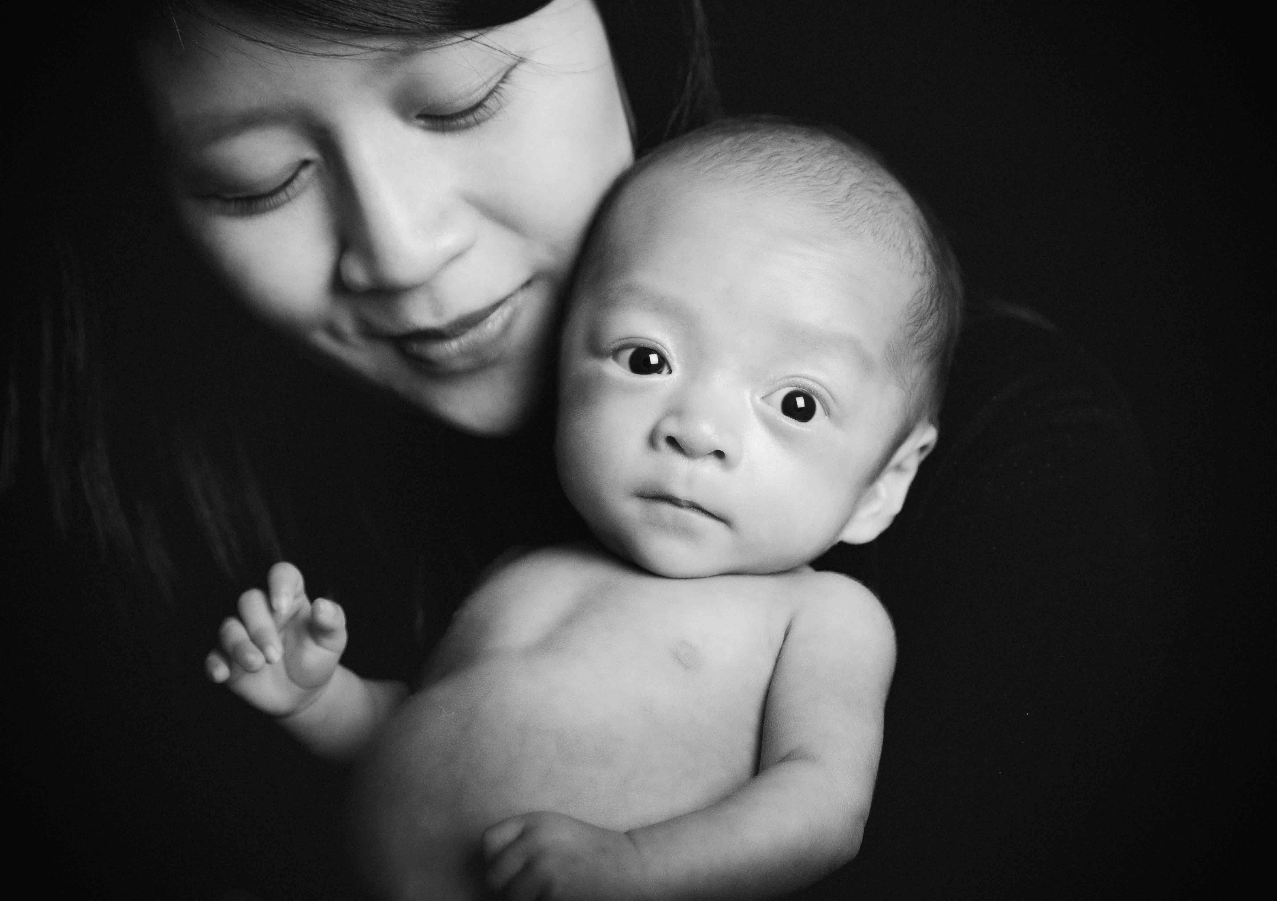
Current Perinatal Services at SUPT
Options for Recovery Program:
Residential Treatment, Recovery Residences/ Sober Living, Intensive Outpatient Treatment, Outpatient Treatment, Recovery Services
Medication Assisted Treatment Specialty Services for Pregnant Women

Slide 11
Service Needs/Gaps
Although we have a high rate of prenatally substance exposed infants and children, many providers do not have specific interventions for prenatal substance exposure.
Increasing screening and referrals of women using substances while pregnant could reduce the number and severity of children prenatally exposed to substances and encourage women to participate in treatment.
Information on the impacts of prenatal substance exposure on the developing child and adolescent is not readily available or used in Sacramento County.
Providing consistent information among a number of different disciplines would give Sacramento County Providers (Substance Use, Medical Providers, Behavioral Health, Social Workers and other community partners) a common language and understanding to treat children with prenatal substance exposure.

Slide 12
Proposal/ Goals
A screening tool for pregnant women to identify potential substance use and refer for early intervention and treatment services.
Provide education to professionals in the community who interact with pregnant women who use substances and children who have had prenatal substance exposure.
Media campaign for providers encouraging an increase in knowledge in the area of prenatal substance exposure including articles in the Sierra Sacramento Valley Medical Society Magazine.
Media campaign encouraging mothers to seek treatment early.

Slide 13
Timeline
April 12th 1:30 pm- Overview of Prenatal Substance Exposure and Website Launch.
May 3rd 1:30-3:00pm- Second Stakeholders Meeting.
May 23rd and May 24th (One Day Training- offered two different days). Prenatal Substance Exposure, Pregnancy and the Infant.
August 9th and August 10th (One Day Training- offered two different days). Prenatal Substance Exposure, Impact on the Developing Child.
November 1st and November 2nd – Specialized Training Series. Topics to be chosen after survey of stakeholders.
May through December 2022- Webinars- topics to be decided with stakeholder input.

Slide 14
Logo Chosen By Stakeholders

Slide 15
Feedback From Stakeholders
Information about partnering and working together was used to reach out to additional interested stakeholders. bessem@saccounty.net
Training selections were designed around the input which will be voted on today.
Vote at: https://bit.ly/sachb-summer-webinar-survey. (Link in the chat and will be sent out after todays meeting.
Stakeholders who requested additional information were contacted.
Capacity and outreach addressed through stakeholders survey.

Slide 16
April 12th Success
Over 180 professionals attend our kickoff event

Slide 17
SACCounty Healthy Beginnings Website
Sachealthybeginnings.com
Website Launch
Training sign up for in person and zoom training May 23 or 24
Videos and excerpts from trainings
Coming Soon- Provider Tools

Slide 18
Social Media Launched May 9th

Slide 19
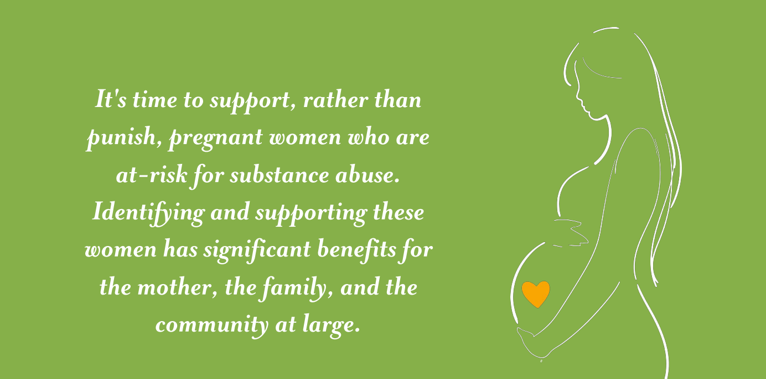
It’s time to support, rather than shame, pregnant women who are at-risk for substance use. Identifying and supporting these women has significant benefits for the mother, the family and the community at large.

Slide 22
Screening Pregnant Women
We are looking for sites interested in using the screening tool to begin screening pregnant women.
No cost for the tool which will be provided by the SACCounty Healthy Beginnings initiative.
Women in need will be referred to treatment through Sacramento County, Substance Use Prevention and Treatment Services.

Slide 23
References
Questions?
Michelle Besse LMFT, Program Planner bessem@saccounty.net
https://pubmed.ncbi.nlm.nih.gov/25599434/
US National Library of Medicine https://www.ncbi.nlm.nih.gov/pmc/articles/PMC4374990/
Children, Family, Futures Report 2018
Sacramento County Public Health
Sacramento County Department of Child, Family and Adult Services

