Slide 1
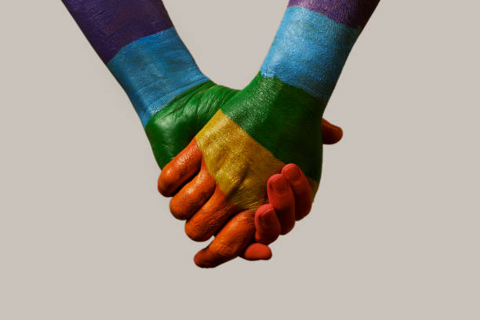
METHAMPHETAMINE USE AMONG DIVERSE POPULATION
Kimberly Grimes, program planner
Division of behavioral health services
Substance use prevention and treatment services

Slide 2
2019 National Survey On Drug Use And Health: Lesbian, Gay, & Bisexual (LGB) Adults
(SAMHSA, 2019)

Slide 3
Meth Popularization in Queer Teens
- The prevalence of meth use rose in the 1990s at dance clubs, became deeply ingrained in club/queer culture
- Grindr, popular dating and hookup app, was established in 2009, and facilitated the spread of meth use
- the diamond emoji, “party and play”
- “instant” delivery of sex and drugs
NBC news, castcenter

Slide 4
Meth Popularization cont.
- Meth use associated with risk tasking, exacerbates HIVs harm to the body and increases transmission of STIs
- Clinical trial based in SF showed that gay men who recently used meth were - 2x as likely to contract AIDS, 5x as likely to contract syphilis
- Compounded effects of physical and mental stress
NBC news, castcenter

Slide 5
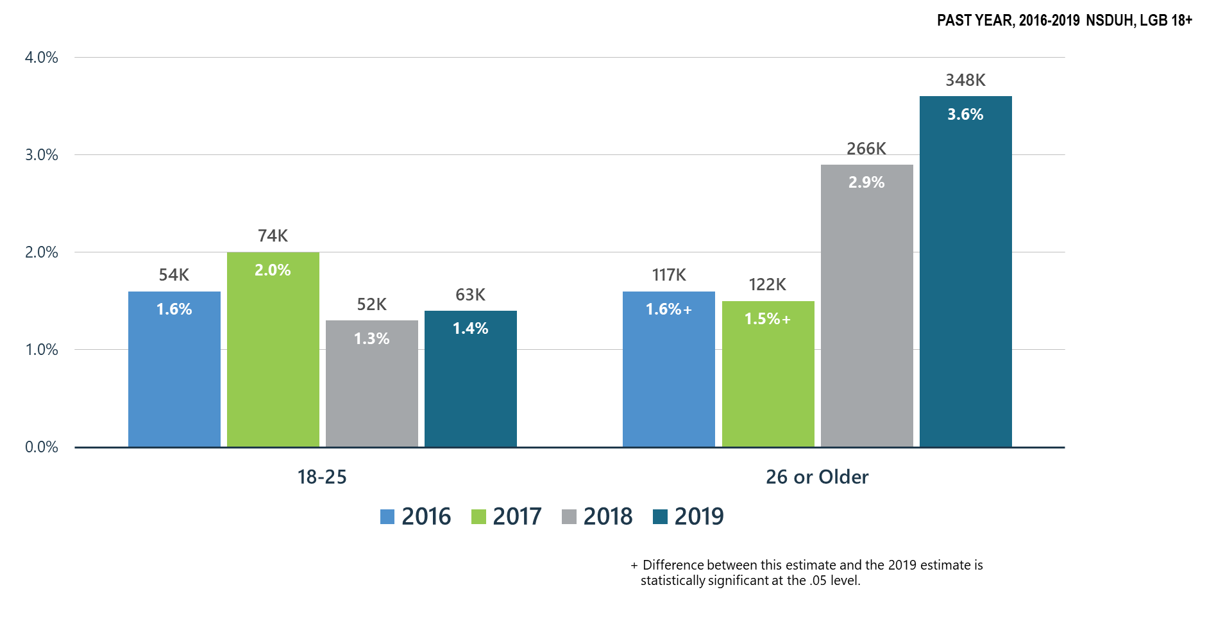
Methamphetamine Use among LGB Adults

Slide 6
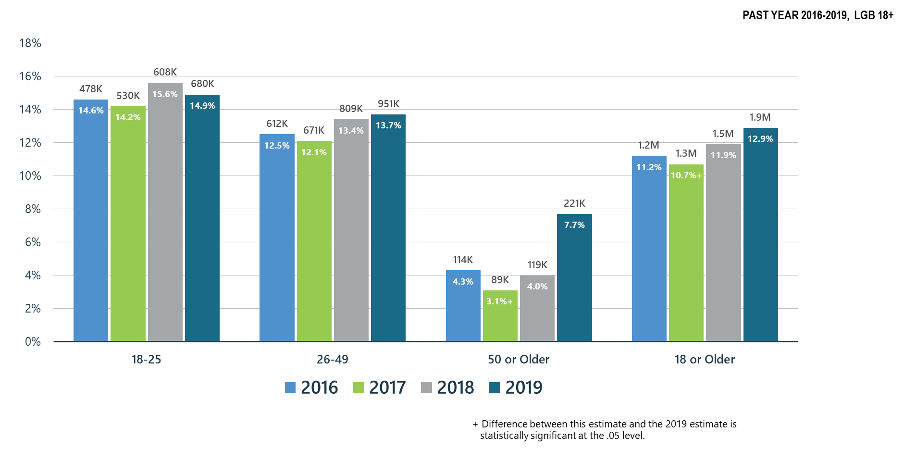
Co-Occurring Substance Use Disorder and Any Mental Illness in LGB Adults

Slide 7
Mental and Substance Use Disorders among LGB Adults: High Prevalence/Huge Treatment Gaps

Slide 8
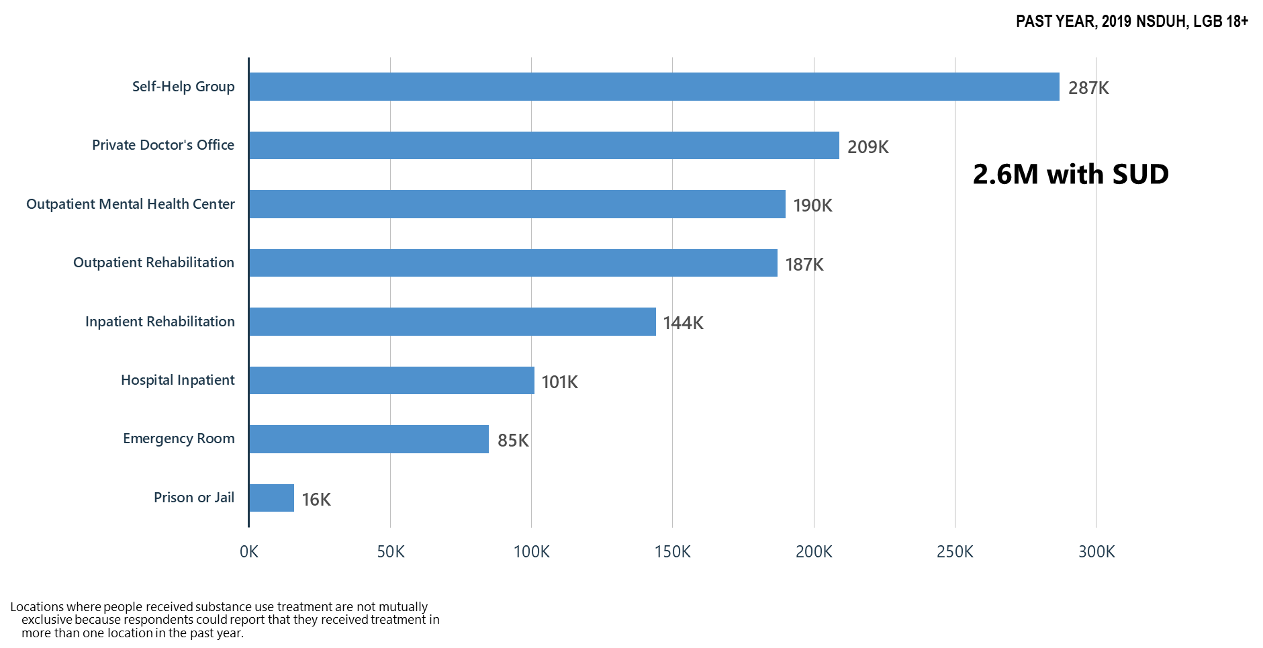
Locations Where Substance Use Treatment was Received among LGB Adults

Slide 9
Methamphetamine and the Black LGBTQ Community
Startling facts:
Over the last decade, Black gay communities have witnessed a significant increase in the use of methamphetamine.
More Black men reported methamphetamine use than White men (28.1% vs. 15.2%).
In a 2020 study of a small group (560) Black men who identified as gay and/or bisexual and use meth in club settings:
Average age was 32 years old
43.9% reported cocaine use and meth use within last 4 months
These participants in this study were also more likely to be HIV-positive
These participants also use a variety of other substances recreationally, such as alcohol and inhalants
(National Library of Medicine, A Comparative Analysis of Methamphetamine Use: Black Gay and Bisexual Men in Relation to Men of Other Races)

Slide 10
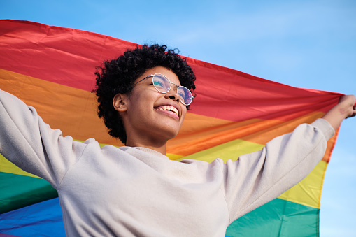
Why is this important?
To shed light on the nuance and disparities, as they feel isolated, because they’re a queer person of color.
Because problems stem from the fact that people feel like they can’t talk about their meth use if it’s stigmatized in their community.
Black LGBTQ feel they will be ostracized by friends and family if they tell people they’re using meth.
White gay men who use typically have more privilege. They are more likely to have better paying jobs, be housed, or be more comfortable going into mental health services or treatment programs. While Black LGBTQ tend to be more able to use meth discretely with all of those privileges. That’s why Black men who have sex with men may be disproportionately affected by their use.
(Quotes from SF AIDS Foundation, March 2019)

Slide 11
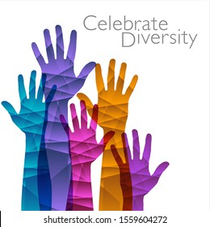
THANK YOU!
Please feel free to reach out with any resources that may be of assistance to diverse populations suffering with a Methamphetamine Use Disorder.
KIMBERLY GRIMES,
BHS-SUPT PROGRAM PLANNER,
BHREC COMMITTEE MEMBER
916-875-2038
grimesk@saccounty.net

