Slide 1
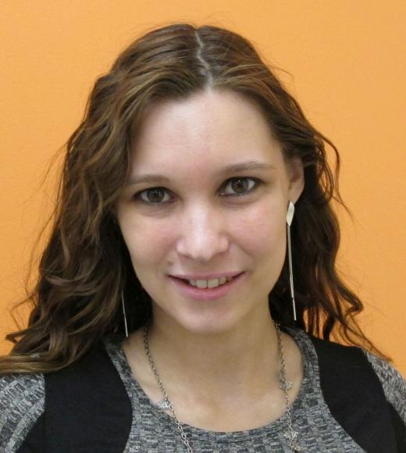
Trauma and Substance Use Disorders
PRESENTER
MARIA USACHEVA, Ph.D.
Senior Research Analyst II

Slide 2
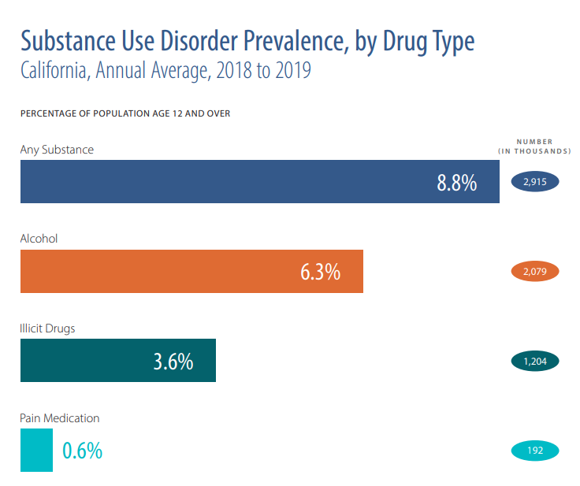
SUBSTANCE USE DISORDERS
In 2022, of all Californians 12 years and older:
50% of used alcohol
20% used marijuana
9% (2.5 mil) had a substance use disorder
From 2011 to 2019:
10 times increase in fentanyl overdose deaths (250 in Sacramento County)
From 2018 to 2020:
50% increase in amphetamine-related ED visits
2 times increase in opioid-related ED visits
California Health Care Foundation, 2022. Substance Use in California: Prevalence and Treatment
National Survey on Drug Use and Health (NSDUH), 2019

Slide 3
SUDs-RELATED OUTCOMES
OUTCOMES LINKED TO SUDs:
Higher Morbidity & Mortality:
Health Complications
Mental Health Issues
Suicide
Accidents
Lower Quality of Life:
Relational Difficulties (family, work)
Employment & Financial Difficulties
Legal Issues
Homelessness
…and more

Slide 4
RISK-OUTCOME RELATIONSHIPS
Mental Health
Social - Environmental
Mental Health
Trauma / ACEs
Trauma / ACEs
SUDs
Chronic Stress
Chronic Stress
Low Social Support
Low Social Support
Biological - Genetic
Financial Hardship
Financial Hardship

Slide 5
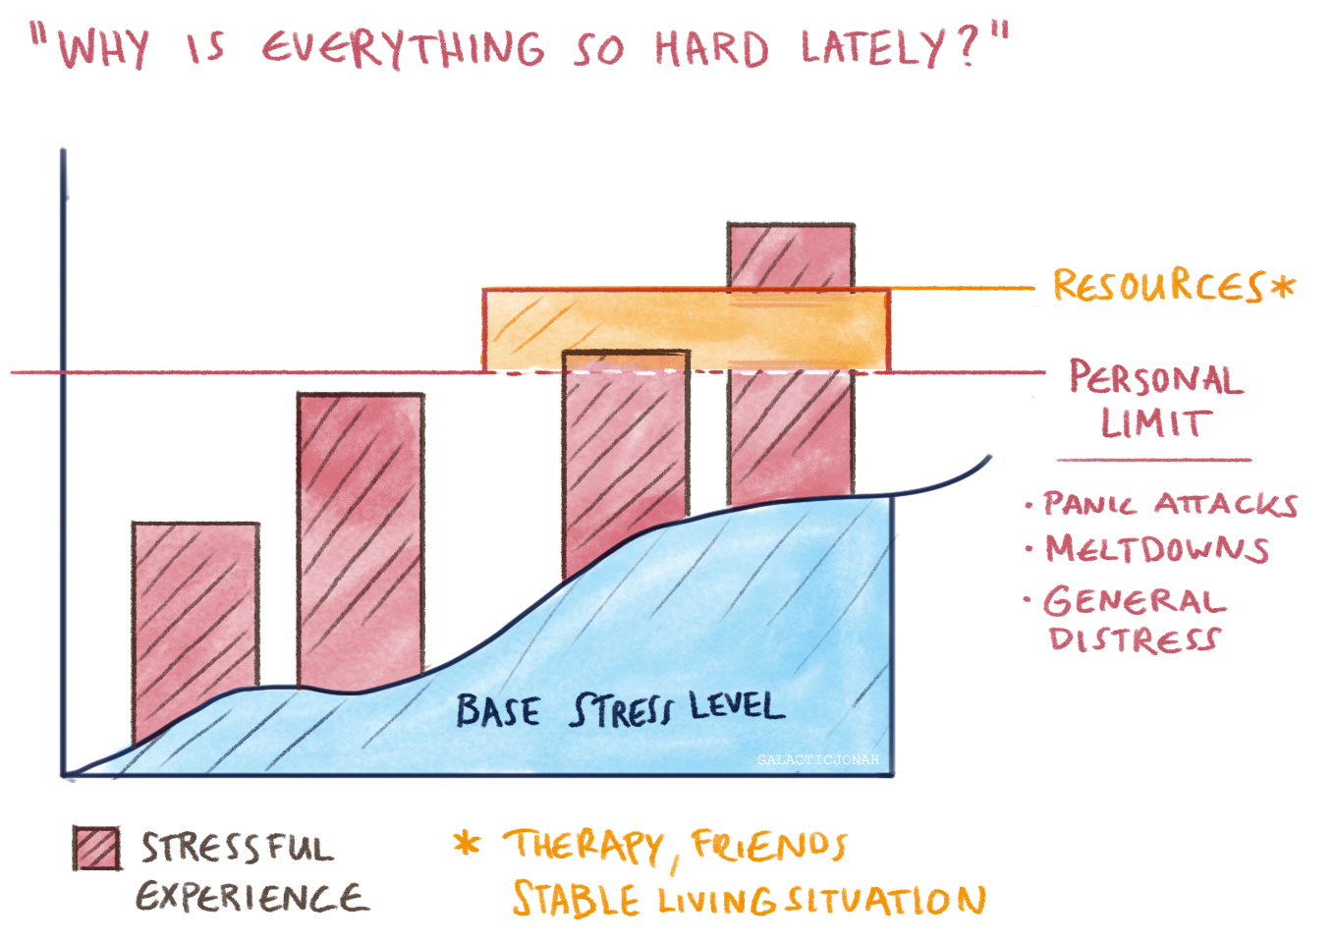
BIOLOGICAL RESPONSE TO STRESS
CUMULATIVE RISK MODELS
Adverse Childhood Experiences
Diathesis-Stress
Allostatic Load
Cicchetti, 2010; Evans & Whipple, 2013; Danese & McEwen, 2012; Felitti et al., 1998

Slide 6
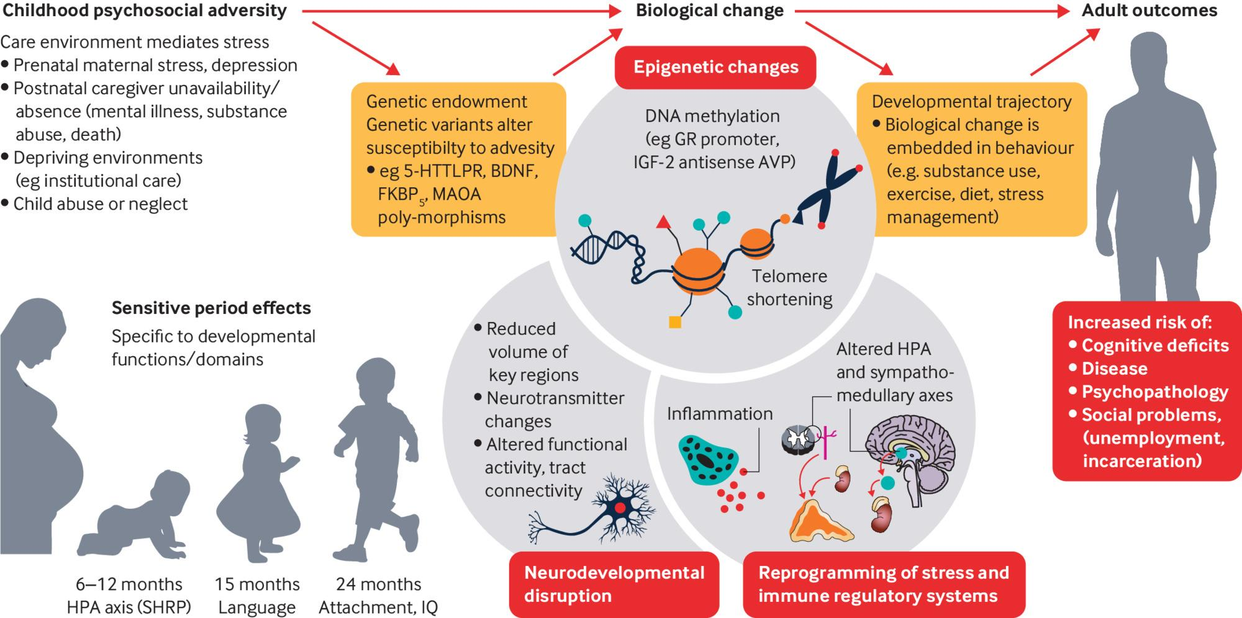
EPIGENETICS & PHYSIOLOGY

Slide 7
DIMENSIONAL ADVERSITY

Slide 8
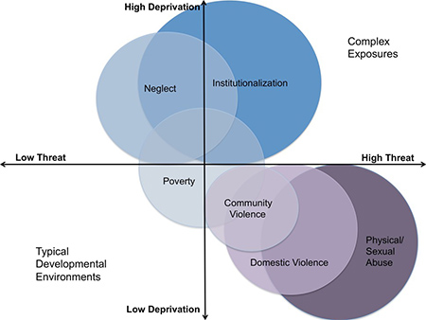
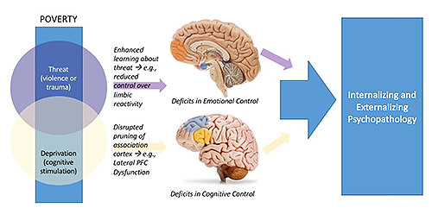
THREAT-DEPRIVATION FRAMEWORK
aggressive behavior
cognitive deficits
McLaughlin et al., 2014; Lambert et al., 2014, etc.

Slide 9
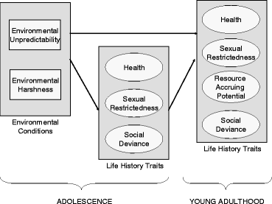
HARSHNESS - UNPREDICTABILITY FRAMEWORK
HASRSHNESS
DEPRIVATION
Low SES
Food insecurity
Material hardship
Belsky, Schlomer, Ellis, 2012
THREAT
Abuse, domestic violence
Family dysfunction
High conflict
Many romantic partners
UNPREDICTABILITY
HH Chaos
Changes in HH composition
Changes in employment
Residential mobility
CHILDHOOD

Slide 10
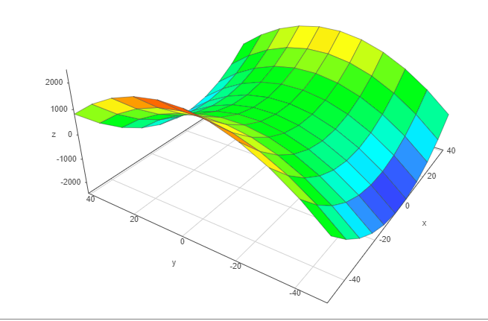
MULTIDIMENSIONAL DEVELOPMENTAL CONTEXT
Dimensions = positive-to-negative continuums
3 Dimensions = 3 primary color spectra
Squares = intersections of 3 dimensions
Square colors = overlay of 3 primary colors
Early Life Stress
Fast
Life Histories
Slow
Life Histories
x
Stability
Unpredictability
y
Resource Abundance
Deprivation
z
Safety
Threat

Slide 11
LIFE HISTORY THEORY
Life Expectancy
EMOTIONAL WELLNESS
Prosociality
Self-regulation
IQ, EF, future planning
Aggression/risk-taking
Fast
Life Histories
PHYSICAL HEALTH
Health & growth
Life span
Puberty
Maturation & Reproduction
Early Life Stress
Slow
Life Histories
SOCIAL BEHAVIOR
Romantic partners
Number of children
Parental investment
Birth Child Youth Adult Older Adult
Ellis et al., 2009; Del Giudice, Gangestad, & Kaplan, 2016

Slide 12
Slow Life Histories
Safe, Nurturing, Stable Environment → Expectation of a Longer Life ➔ No Need to Fight for Resources → Investment in Development → Investment in Children
Developmental Focus:
Health
Brain Development
Self-Regulation
Long-Term Planning
Social Skills
Relationships
Developmental Outcomes:
Longer Sexual Maturation
Fewer Sexual Partners
Fewer Children
Nurturing Parenting
Investment in Children
Social Support and Help

Slide 13
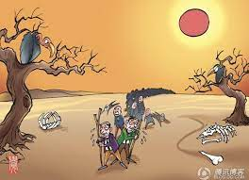
Fast Life Histories and Risk Behavior
Violent, Poor, Unstable Environment → Expectation of a Shorter Life ➔ Fight for Resources → Investment in Procreation → Low Investment in Children
Developmental Focus:
Earlier Sexual Maturation
Creative Problem-Solving
Aggression
Risky Behavior / Instant Gratification
Empathy/ Generosity
Developmental Outcomes:
Earlier Sexual Activity
More Sexual Partners
More Children
Harsh Parenting
Low Investment in Children
Low Social Support

Slide 14
Unpredictability and Substance Use
Unstable Environment → Future not Predictable ➔ Instant Rewards over Planning Ahead→ Risky Behavior → Substance Use Disorders
Unpredictable Environment is Hard to Adapt to:
Risky Behavior -> Brain Reward Center
Delayed Gratification → Instant Gratification
Risky Behavior
Self-Medication “to escape stress/ pain/ uncertainty”
Relational Conflict → Low Social Support

Slide 15
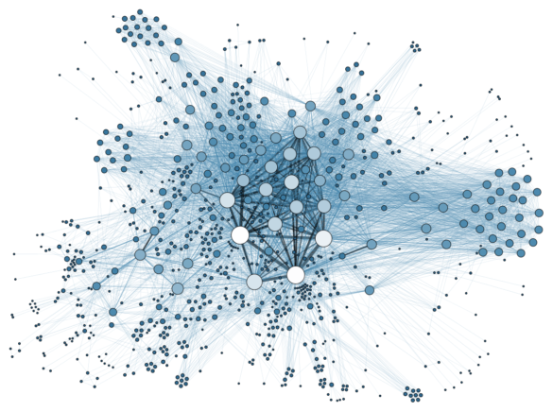
IMPLICATIONS:
CUMULATIVE RISK OR DIMENSIONAL ADVESITY?

Slide 16
QUESTIONS?
Thank you for your feedback!

