Slide 1
Homeless Engagement and Response Team (HEART)
Department of Health Services
Division of Behavioral Health Services (BHS)

Slide 2
HEART Purpose and Values
Mental Health First
Shelter/permanent housing as significant secondary priority
Meaningful relationships with partners who have a housing first model
Recovery Oriented
Person-centered, collaborative, strengths based
“Whatever it Takes” mentality
Creative thinking and innovative approaches to service
Equity of access to services
Reduce barriers by bringing services to the client

Slide 3
HEART Team
12 Mental Health Counselors
Engage and build rapport/trust within the identified encampments on a weekly basis.
Conduct clinical assessments to determine need for further mental health or substance use prevention and treatment and at what level of service.
Admit client to directly to mental health providers.
Provide crisis intervention as appropriate.
Coordinate with social services providers for benefits acquisition, housing, shelters, medical care, etc.
Provide psycho-education regarding symptoms, symptom management and treatment options.
Coordinate with mental health providers, system partners, and community partners.

Slide 4
HEART Team
10 Behavioral Health Peer Specialists
Share personal lived experiences relating to homelessness, housing insecurity and/or behavioral health and recovery services in a variety of settings, including person-to-person, small and large groups, and public presentations.
Provide information, education, training and technical assistance on consumer and family member perspective for behavioral health system providers and partners.
Support client and family involvement in services through client-centered engagement.
Participate in countywide regional outreach activities related to Behavioral Health services.
Support clients prior to and during appointments, with the goal of increasing the client’s engagement with service providers and decreasing the stress and anxiety of these appointments.

Slide 5
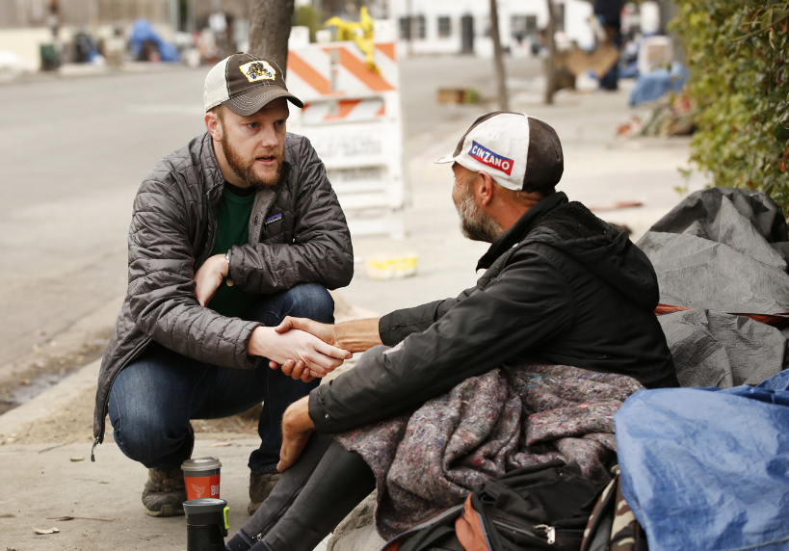
Phased Approach
Outreach
Meet the client literally where they are at (i.e. camps/shelters)
Build rapport
Engagement
Foster trust
Basic questioning
Offering info about services
Screening
Begin to determine what level of care is necessary
Explain to clients what linkage to service requires, i.e. what is their participation expectation
Assessment
Clinical evaluation of symptoms and needs
Referral/Linkage
Counselors refer to Mental Health Plans
Peers may support linkage to concrete needs and support initial MHP appointments/engagement
Notes:
This applies primarily to Encampment Team, as typically shelter referrals will come from shelter staff who have built some rapport with individuals already. SOT will still use this phased approach as appropriate.

Slide 6
BHS Programs
Managed Care Plans
CORE Programs
Redesigned to provide broad geographic options to community
10 locations
Community Wellness Centers
Moderate to moderate-high intensity outpatient treatment
Full Service Partnerships (FSPs)
High intensity outpatient treatment
Crisis response services
Housing dollars and permanent supportive housing options

Slide 7
CORE Site | Outpatient Program | Community Wellness Center​
1. El Hogar CORE Mariposa 600 Bercut Dr, Sacramento, CA 95811 Phone: 916-440-1500/ Fax: 916-440-1514 | Open / Walk-in Hours (date/time): Wednesdays: 9:00am-11:00am Thursdays: 1:00pm to 3:00pm | Open Mariposa Group Calendar: Click Here​
2. Turning Point CORE Rosin 3810 Rosin Ct, Suite 170, Sacramento. CA 95834 Phone: 916-567-4222/ Fax: 916-567-4220 | Open / Walk-in Hours (date/time): Mondays: 8:30am-12:30pm Wednesdays: 12:30pm-4:00pm Thurdays: 12:30pm-4:00pm | Open Rosin Group Calendar and Catalog: Click Here​
3. Turning Point CORE Madison 3628 Madison Ave, Suite 6, North Highlands, CA 95660 Phone: 916-388-3231/ Fax: 916-388-3232 | Open / Walk-in Hours (date/time): Mondays: 8:30am-12:30pm Wednesdays: 12:30pm-4:00pm Thurdays: 12:30pm-4:00pm | Open Madison Group Calendar and Catalog: Clic​k Here​
4. El Hogar CORE Marigold​ Outpatient Program: 8421 Auburn Blvd, Suite 164, Citrus Heights, CA 95610 Community Wellness Center: 8421 Auburn Blvd, Suite 162, Citrus Heights, CA 95610​ Phone: 916-441-3819/ Fax: 916-441-6377​ | Open / Walk-in Hours (date/time): Mondays: 9:00am-11:00am Wednesdays: 1:00pm-3:00pm Thursdays: 9:00am-11:00am | Open Marigold Group Calendar: Click Here​
5. Hope Cooperative CORE Marconi 3737 Marconi Ave, Sacramento, CA 95821 Phone: 916-480-1801/ Fax: 916-480-1809 | Open / Walk-in Hours (date/time): Mondays: 1:00pm-3:30pm; Wednesdays: 9:00am-11:30am Fridays 9:00am-11:30am | Open Marconi Group Calendar: Click Here​
6. Hope Cooperative CORE Howe 6a Temp. Site: 3727 Marconi, Sacramento, CA 95821 Phone: 916-485-6500/ Fax: 916-485-6814 6b Future Site: 650 Howe Ave Bldg. 300, Sacramento, CA 95825. Individuals opened to the temp. site will be notified by the provider as soon as the future site is ready. | Open | Not available at temp. site
7. BACS CORE Sycamore Outpatient Program: 9343 Tech Center, Suite 175, Sacramento, CA 95826 Community Wellness Center: 9333 Tech Center Dr, Suite 100, Sacramento, CA 95826 Phone: 916-379-7964/ Fax: 916-379-7964 | Open / Walk-in Hours (date/time): Wednesdays: 9:00am-11:00am Friday: 1:00pm-3:00pm | Open Sycamore Group Calendar: Click Here
8. BACS CORE Cedar 4600 47th Ave, Suite 111, Sacramento, CA 95824 Phone: 916-318-0141/ Fax: 916-318-0141 | Open / Walk-in Hours (date/time): Tuesdays: 11:00am-1:00pm Thursdays: 11:00am-1:00pm | Open​ Cedar Group Calendar: Click Here​
9. Turning Point CORE Elk Grove 9340 E. Stockton Blvd, Elk Grove, CA 95624​ | ​Open / Walk-in Hours (date/time): Mondays: 12:30pm-4:00pm Thursdays: 12:30pm-4:00pm | ​Open Elk Grove Group Calendar and Catalog: Clic​k Here​
​10. BACS CORE Willow 7171 Bowling Dr, Suite 300, Sacramento, CA 95823 | Opening early 2023* | ​Opening early 2023​*​
11. Hope Cooperative CORE X Street 1400 X Street, Sacramento, CA 95818​​ | ​Opening summer 2023* | ​Opening summer 2023*

Slide 8
HEART Collaboration
​​​​​​​​​​​​​Department of Community Response​​
​​​​​​​​​​​​​Department of Homeless Services and Housing​​
Notes:
Sacramento County Department of Human Assistance
Sacramento County of Homeless Initiatives
City of Sacramento Department of Community Response
Sacramento Covered
Sacramento Steps Forward
Local jurisdictions and Community Based Organizations (CBO’s)

Slide 9
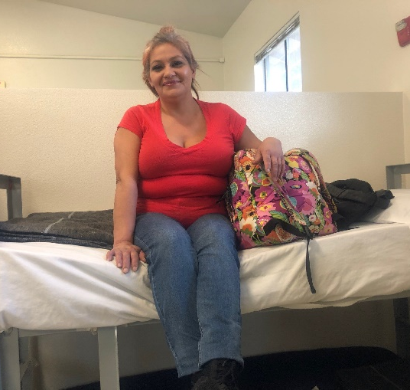
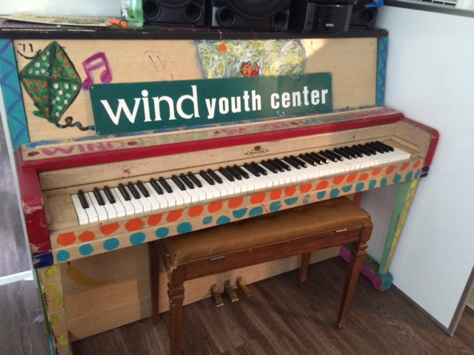
Shelter Outreach Team Partners
First Step Communities North A (Adult Single)
First Step Communities The Grove (TAY)
Volunteers of America (VOA) Meadowview (Adult Women)
VOA Bannon (Families)
Next Move Mather (Adult Singles, Families)
Goodwill Common Ground (TAY)
Wind Youth Services (TAY)

Slide 10
How to refer to HEART
Submit referral to BHS-HEARTReferrals@saccounty.gov
Call 916-875-1720
Required client info:
First and last name
Date of birth
Area in which they reside
Closest exact address is ideal
Zip code
Helpful reminders:
What are their symptoms? Do they want services?
988 for crisis
Housing only?
Psychiatric meds only?

