Slide 1
Methamphetamine Awareness Day
Department of Health Services
Division of Behavioral Health
November 7, 2023
Lori Miller, Division Manager
Substance Use Prevention and Treatment Services

Slide 2
Methamphetamine Awareness Day November 30, 2023
To bring awareness to methamphetamine use disorder and the elimination of methamphetamine use and abuse as one of our highest priorities.
This day plays an important role in highlighting nationwide and local efforts to increase education and awareness about the dangers of methamphetamine and the help and resources available to those in the community who need it most.
.
2
November 7, 2023
Department of Health Services – Methamphetamine Awareness Day

Slide 3
Meth Intoxication Deaths
within Sacramento County
Calendar Year 2021 | Calendar Year 2022 | Calendar Year 2023 (thru May 30)
250 | 280 | 76
Source: Sacramento County Coroner
3
November 7, 2023
Department of Health Services – Methamphetamine Awareness Day

Slide 4
Age Range
55-64 years
Gender
Males
Race/Ethnicity
Caucasian
Black/African American
Zip Codes with Highest Meth Deaths
Highest
Number of Deaths
Zip Code | Vicinity/Neighborhood
95825 | Sacramento (Arden Arcade)
95823 | South Sacramento
95815 | North Sacramento
95608 | Carmichael
95816 | East Sacramento
95838 | Sacramento (Del Paso Heights)
95660 | North Highlands
95817 | Sacramento (Fairgrounds)
95621 | Citrus Heights
95814 | Downtown Sacramento
95811 | Sacramento (Alkali Flats)
95828 | Sacramento (Florin/Lemon Hill)

Slide 5
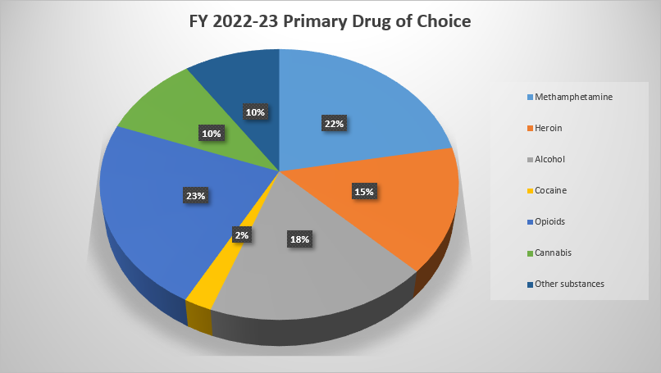
Primary Drug of Choice
5,359 DMC Admissions
(July 1, 2022 – June 30, 2023)
Opioids: 1,216 (23%)
Methamphetamine: 1,185 (22%)
Alcohol: 988 (18%)
Heroin: 811 (15%)
Cannabis: 528 (10%)
Other Substances: 507 (9%)
Cocaine: 124 (2%)
Source: Sacramento County Behavioral Health Services
Avatar Electronic Health Record
5
November 7, 2023
Department of Health Services – Methamphetamine Awareness Day

Slide 6
Addressing meth through partnerships

Slide 7
Methamphetamine Treatment Options
Sacramento County
Sacramento County offers evidenced-based and innovative treatment options for methamphetamine use, including:
Methamphetamine residential treatment
Outpatient and intensive outpatient treatment (virtual and/or in-person)
Medication assisted treatment pilot (bupropion and naltrexone)
Treatment for co-occurring and polysubstance identified needs
7
November 7, 2023
Department of Health Services – Methamphetamine Awareness Day

Slide 8
METHAMPHETAMINE COALITION
Together, We Change Lives
OUR MISSION
WHO WE ARE
Prevent methamphetamine use and addiction through increasing awareness, expanding treatment access, promoting prevention messaging, encouraging early intervention, treatment and recovery, and enhancing and expanding public education and media outreach
Healthcare professionals,
community-based organizations,
law enforcement, county agencies, and concerned citizens
For quarterly meeting schedule: https://letstalkmeth.org/events/
8
November 7, 2023
Department of Health Services – Methamphetamine Awareness Day

Slide 9
Launched in November 2020, Let’s Talk Meth targets people struggling with methamphetamine and their support systems, and includes a toolkit and resources for use by community members, partners, and stakeholders
The purpose of the campaign is to decrease
methamphetamine use in Sacramento County
while increasing enrollment in substance
use prevention and treatment programs
Let’s Talk Meth also aims to target stigma
reduction
9
November 7, 2023
Department of Health Services – Methamphetamine Awareness Day

Slide 10
10
November 7, 2023
Department of Health Services – Methamphetamine Awareness Day

Slide 11
ThANK YOU
Lori Miller, LCSW | Division Manager
Substance use prevention and treatment services
Department of health services
Division of behavioral health
millerlori@saccounty.gov
916-875-2046
11
November 7, 2023
Department of Health Services – Methamphetamine Awareness Day

