Slide 1
Methamphetamine Coalition
Department of Health Services
Division of Behavioral Health
Lori Miller, LCSW | Division Manager
Substance Use Prevention and Treatment Services

Slide 2
ACKNOWLEDGEMENTS: aug 21 - National FENTANYL PREVENTION AND AWARENESS DAY aug 31 – INTERNATIONAL OVERDOSE AWARENESS DAY SEPT 4 - RECOVERY HAPPENS EVENT AT STATE CAPITAL WEAR PURPLE
.
2

Slide 3
Methamphetamine Awareness
Meth continues to be a serious drug threat to Sacramento County
Forgotten Killer
Underemphasized, Overshadowed
Arrests Alone Cannot Solve This Problem
500 people each day try meth for the first time - SAMHSA
.

Slide 4
Notes:
Opiates – Fentanyl, Morphine, Codeine, Hydrocodone, Oxycodone, Heroin, MAT services (Buprenorphine, Methadone, Naltrexone).

Slide 5
Primary Drug of Choice: Methamphetamine Use Data
Unduplicated Clients Admitted with Primary Drug of Choice as Methamphetamine
 | CY2022 | CY2023
Unduplicated Clients Meth | 1459 | 1502
Unduplicated Clients Meth & Unhoused | 465 | 431
% Clients with Meth and Unhoused Seeking SUPT Treatment | 31.9% | 28.7%
Notes:
CY= Calendar Year

Slide 6
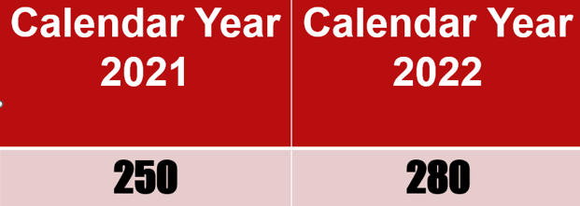
METH RELATED DEATHS
Calendar year
2023 = 342

Slide 7
2023 Methamphetamine Related Deaths

Slide 8
Data provided by the Sacramento County Coroner’s Office

Slide 9
Data provided by the Sacramento County Coroner’s Office

Slide 10
Data provided by the Sacramento County Coroner’s Office

Slide 11
Data provided by the Sacramento County Coroner’s Office

Slide 12
What’s new?

Slide 13
New Fentanyl blog launch
New documentary blog series, The Ripple Effect, produced for Safer Sacramento, as part of their National Fentanyl Awareness Day outreach campaign.
This new series integrates fact-based research and multimedia content to bring personal perspectives and expert testimony to the forefront.
The new series sheds light on the harrowing reality of the fentanyl crisis in the U.S. and its impact on Sacramento County. Each installment delves deep into the multifaceted aspects of this epidemic, exploring its origins, impact on families and the community, and the relentless efforts to combat this crisis.
Read Part 1: Illicit Fentanyl’s Origin Story at www.safersacramento.com/blog/illicit-fentanyls-origin-story.
.
www.safersacramento.com

Slide 15
Addressing Meth Through Partnerships Thank you!
Alcohol and Drug Advisory Board
Criminal Justice Reform Committee
Community-Based Providers
Law Enforcement: Police Departments
Sacramento Sheriff’s Office
Sacramento Superior Court
Public Defender, District Attorney
Probation Department
Department of Child, Family and Adult Services
High Intensity Drug Trafficking Agency
US Attorney’s Office
Sacramento County Coroner’s Office

Slide 16
questions
Lori Miller, LCSW | Division Manager
Substance use prevention and treatment services
Division of behavioral health
Department of health services
millerlori@saccounty.gov
916-875-2046

