Slide 1
Methamphetamine Coalition
Department of Health Services
Division of Behavioral Health
Lori Miller, Division Manager
Substance Use Prevention and Treatment Services

Slide 2
Acknowledgements: National Womens’ History month national alcohol and drugs facts week March 18-24
.
2

Slide 3
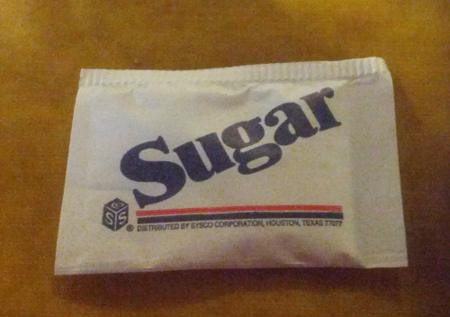
Methamphetamine Awareness
Meth continues to be a serious drug threat is Sacramento County
Forgotten killer
Underemphasized
1 packet of sugar is the size of 16 meth doses – SAMHSA
500 people each day try meth for the first time - SAMHSA
.
3

Slide 4
Meth Intoxication Deaths
within Sacramento County
Calendar Year 2021 | Calendar Year 2022 | Calendar Year 2023 (Jan-Oct)
250 | 280 | 148
4

Slide 5
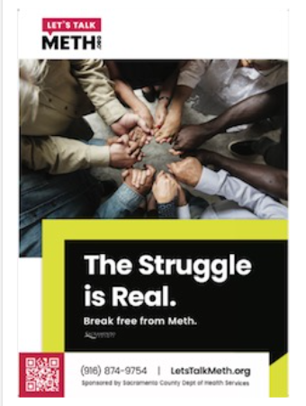
Methamphetamine
Handouts
Available
SaferSacramento.com

Slide 6
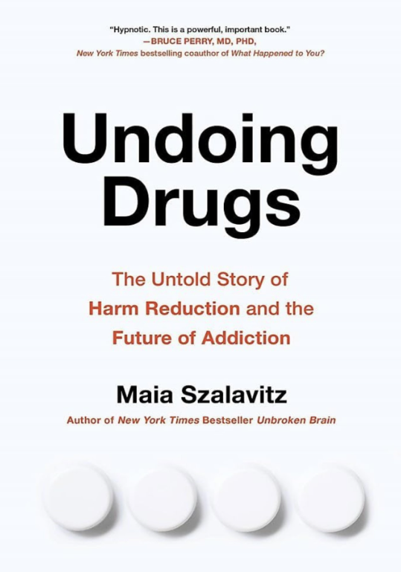
Book – “Undoing Drugs” Harm Reduction
.
In a spellbinding narrative rooted in an urgent call to action, Undoing Drugs tells the story of how a small group of committed people changed the world, illuminating the power of a great idea. It is about how personal, direct human connection and kindness can inspire profound transformation.
Undoing Drugs offers a path forward—looking at the treatment of addiction and our treatment of behavioral and societal issues
6

Slide 7
7

Slide 8
Addressing meth through partnerships

Slide 9
Thank you!
Alcohol and Drug Advisory Board Criminal Justice Reform Committee
Community-Based Providers
Law Enforcement: Police Departments
Sacramento Sheriff’s Office
Sacramento Superior Court/Public Defender, District Attorney
Probation Department
Department of Child, Family and Adult Services
High Intensity Drug Trafficking Agency
US Attorney’s Office
Sacramento County Coroner’s Office
9

Slide 10
ThANK YOU
Lori Miller, LCSW | Division Manager
Substance use prevention and treatment services
Department of health services
Division of behavioral health
millerlori@saccounty.gov
916-875-2046
10

