Slide 1
Methamphetamine Coalition
Department of Health Services
Division of Behavioral Health
Lori Miller, LCSW | Division Manager
Substance Use Prevention and Treatment Services

Slide 2
Acknowledgements: National Treatment Court month Mental health awareness month national prevention week may 12-18 National fentanyl awareness day , may 7
.
2

Slide 3
Methamphetamine Awareness
Meth continues to be a serious drug threat to Sacramento County
Forgotten Killer
Underemphasized, Overshadowed
Arrests Alone Cannot Solve This Problem
500 people each day try meth for the first time - SAMHSA
.

Slide 4
Meth Intoxication Deaths
within Sacramento County
Calendar Year 2021 | Calendar Year 2022 | Calendar Year 2023 (Jan-Oct)
250 | 280 | 148
Source: Sacramento County Coroner’s Office

Slide 5
What’s new?

Slide 6
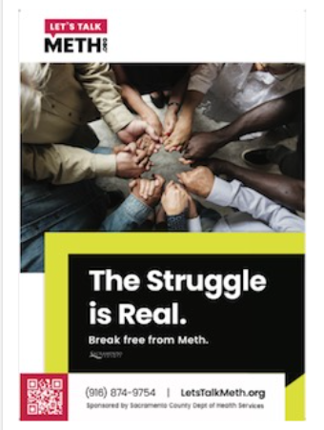
Methamphetamine
Handouts
Available
SaferSacramento.com
Meth Blog
Meth Page
Videos
6

Slide 7
New Fentanyl blog launch
New documentary blog series, The Ripple Effect, produced for Safer Sacramento, as part of their National Fentanyl Awareness Day outreach campaign.
This new series integrates fact-based research and multimedia content to bring personal perspectives and expert testimony to the forefront.
The new series sheds light on the harrowing reality of the fentanyl crisis in the U.S. and its impact on Sacramento County. Each installment delves deep into the multifaceted aspects of this epidemic, exploring its origins, impact on families and the community, and the relentless efforts to combat this crisis.
Read Part 1: Illicit Fentanyl’s Origin Story at www.safersacramento.com/blog/illicit-fentanyls-origin-story.
.
www.safersacramento.com

Slide 8
Partnership Adult Correctional Health Substance use prevention and treatment jail Inmate tablet project substance use resources mental health resources fentanyl education and awareness

Slide 11
Addressing Meth Through Partnerships Thank you!
Alcohol and Drug Advisory Board
Criminal Justice Reform Committee
Community-Based Providers
Law Enforcement: Police Departments
Sacramento Sheriff’s Office
Sacramento Superior Court
Public Defender, District Attorney
Probation Department
Department of Child, Family and Adult Services
High Intensity Drug Trafficking Agency
US Attorney’s Office
Sacramento County Coroner’s Office

Slide 12
questions
Lori Miller, LCSW | Division Manager
Substance use prevention and treatment services
Division of behavioral health
Department of health services
millerlori@saccounty.gov
916-875-2046

